Slide 1
Kubernetes in Action
Part VIII
2026.08.25

Slide 2
Pod’s Computation Resources
Managing Resources in the Pod

Slide 3
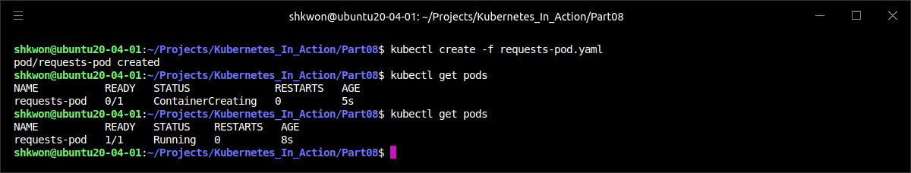
Requesting Resources for a Pod’s Containers(1/13)
Creating Pods with Resource Requests :
  When creating a pod, you can specify the amount of CPU and memory that a container needs (these are called “requests“), and a hard limit on what it may consume (known as “limits”). They’re specified for each container individually, not for the pod as a whole. The pod’s resource requests and limits are the sum of the requests and limits of all its containers.
  The following example has the CPU and memory requests specified for its single container, as shown in the following listing.
apiVersion: v1
kind: Pod
metadata:
name: requests-pod
spec:
containers:
- image: busybox
command: ["dd", "if=/dev/zero", "of=/dev/null"]
name: main
resources:
requests:
cpu: 200m
memory: 10Mi
requests-pod.yaml

Slide 4
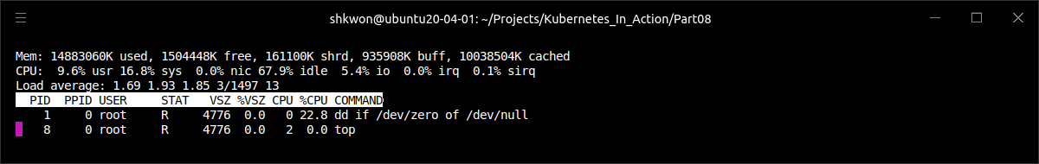
Requesting Resources for a Pod’s Containers(2/13)
Creating Pods with Resource Requests :
  In the previous pod manifest, your single container requires one-fifth of a CPU core (200 millicores) to run properly. Five such pods/containers can run sufficiently fast on a single CPU core.
  When you don’t specify a request for CPU, you’re saying you don’t care how much CPU time the process running in your container is allotted. In the worst case, it may not get any CPU time at all (this happens when a heavy demand by other processes exists on the CPU). Although this may be fine for low-priority batch jobs, which aren’t time-critical, it obviously isn’t appropriate for containers handling user requests.
  In the pod spec, you’re also requesting 10 mebibytes of memory for the container. By doing that, you’re saying that you expect the processes running inside the container to use at most 10 mebibytes of RAM. They might use less, but you’re not expecting them to use more than that in normal circumstances.
  Now you’ll run the pod. When the pod starts, you can take a quick look at the process’ CPU consumption by running the “top” command inside the container, as shown in the following listing.
$ kubectl exec -it requests-pod -- top

Slide 5
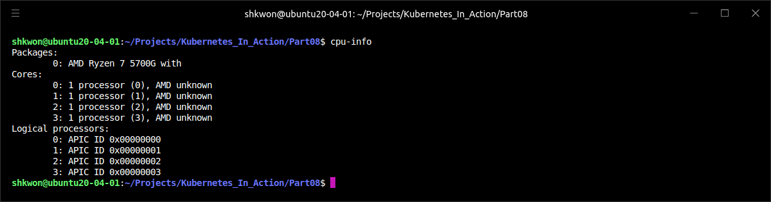
Requesting Resources for a Pod’s Containers(3/13)
Creating Pods with Resource Requests :
  The “dd(data dump)” command you’re running in the container consumes as much CPU as it can, but it only runs a single thread so it can only use a single core. The Minikube VM, which is where this example is running, has four CPU cores allotted to it.
  NOTE : If you want to see how many CPUs are allocated to Minikube, you can run “$ minikube ssh” command and “$ ls -al /dev/cpu” command in the Minikube VM.
  The previous requests don’t limit the amount of CPU a container can use. You’d need to specify a CPU limit to do that.
  NOTE : To see the number of CPUs in your system in Linux Ubuntu, you need to install “cpuinfo” package with “$ sudo apt install cpuinfo” command. Then run “$ cpu-info” command.

Slide 6
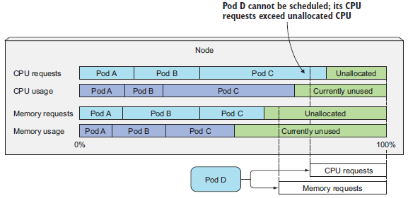
Requesting Resources for a Pod’s Containers(4/13)
Understanding How Resource Requests Affect Scheduling :
  By specifying resource requests, you’re specifying the minimum amount of resources your pod needs. This information is what the Scheduler uses when scheduling the pod to a node. Each node has a certain amount of CPU and memory it can allocate to pods. When scheduling a pod, the Scheduler will only consider nodes with enough unallocated resources to meet the pod’s resource requirements. If the amount of unallocated CPU or memory is less than what the pod requests, Kubernetes will not schedule the pod to that node, because the node can’t provide the minimum amount required by the pod.
  The Scheduler doesn’t look at how much of each individual resource is being used at the exact time of scheduling but at the sum of resources requested by the existing pods deployed on the node. Even though existing pods may be using less than what they’ve requested, scheduling another pod based on actual resource consumption would break the guarantee given to the already deployed pods.
  In the following figure, three pods are deployed on the node. Together, they’ve requested 80% of the node’s CPU and 60% of the node’s memory. Pod D, shown at the bottom right of the figure, cannot be scheduled onto the node because it requests 25% of the CPU, which is more than the 20% of unallocated CPU. The fact that the three pods are currently using only 70% of the CPU makes no difference.

Slide 7
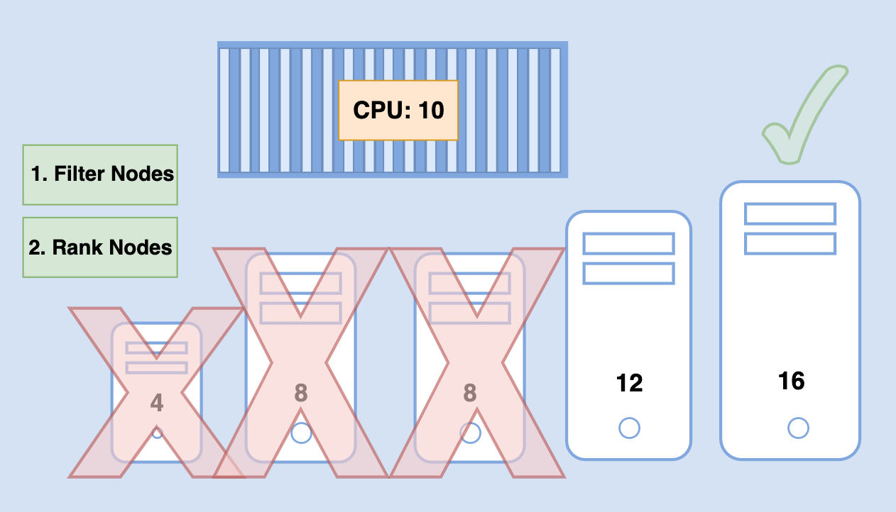
Requesting Resources for a Pod’s Containers(5/13)
Understanding How Resource Requests Affect Scheduling :
  The Scheduler first filters the list of nodes to exclude those that the pod can’t fit on and then prioritizes the remaining nodes per the configured prioritization functions. Among others, two prioritization functions rank nodes based on the amount of resources requested: LeastRequestedPriority and MostRequestedPriority. The first one prefers nodes with fewer requested resources (with a greater amount of unallocated resources), whereas the second one is the exact opposite—it prefers nodes that have the most requested resources (a smaller amount of unallocated CPU and memory). They both consider the amount of requested resources, not the amount of resources actually consumed.
  The Scheduler is configured to use only one of those functions. You may wonder why anyone would want to use the MostRequestedPriority function. After all, if you have a set of nodes, you usually want to spread CPU load evenly across them. However, that’s not the case when running on cloud infrastructure, where you can add and remove nodes whenever necessary. By configuring the Scheduler to use the MostRequestedPriority function, you guarantee that Kubernetes will use the smallest possible number of nodes while still providing each pod with the amount of CPU/memory it requests. By keeping pods tightly packed, certain nodes are left vacant and can be removed. Because you’re paying for individual nodes, this saves you money.

Slide 8
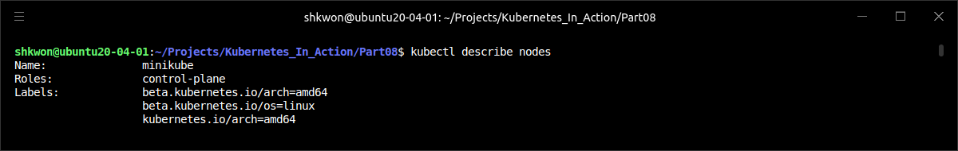
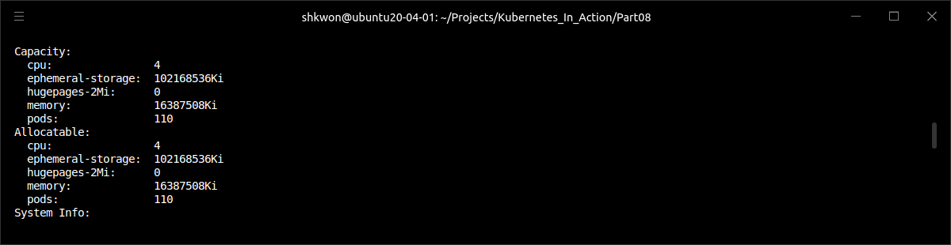
Requesting Resources for a Pod’s Containers(6/13)
Understanding How Resource Requests Affect Scheduling :
  You’ll deploy another pod with four times the amount of requested resources as before. But before you do that, let’s see your node’s capacity. Because the Scheduler needs to know how much CPU and memory each node has, the Kubelet reports this data to the API server, making it available through the Node resource. You can see it by using the “$ kubectl describe” command as in the following listing.
$ kubectl describe nodes

Slide 9
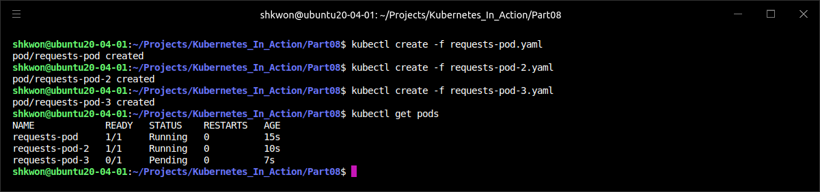
Requesting Resources for a Pod’s Containers(7/13)
Understanding How Resource Requests Affect Scheduling :
  The output shows two sets of amounts related to the available resources on the node : the node’s capacity and allocatable resources. The capacity represents the total resources of a node, which may not all be available to pods. Certain resources may be reserved for Kubernetes and/or system components. The Scheduler bases its decisions only on the allocatable resource amounts.
  In the previous example, the node called “minikube” runs in a VM with four cores and has no CPU reserved, making the whole CPU allocatable to pods.
  Run the pod with the “$ kubectl create” command like this :
$ kubectl create -f requests-pod-2.yaml
$ kubectl create -f requests-pod-3.yaml

Slide 10
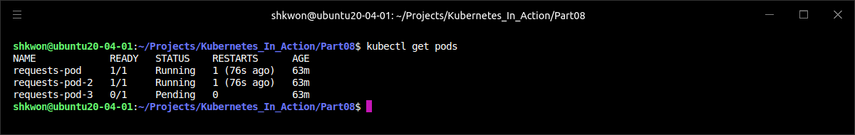
Requesting Resources for a Pod’s Containers(8/13)
Understanding How Resource Requests Affect Scheduling :
  You now have three pods deployed, which together have requested a total of 1,000 millicores(200 + 800) or exactly 1 core. You should therefore have another 3,000 millicores(3 cores) available for additional pods, right? You deployed another pod with a resource request of 3,000 millicores.
requests-pod-2.yaml
apiVersion: v1
kind: Pod
metadata:
name: requests-pod-2
spec:
containers:
- image: busybox
command: ["dd", "if=/dev/zero", "of=/dev/null"]
name: main
resources:
requests:
cpu: 800m
memory: 20Mi
apiVersion: v1
kind: Pod
metadata:
name: requests-pod-3
spec:
containers:
- image: busybox
command: ["dd", "if=/dev/zero", "of=/dev/null"]
name: main
resources:
requests:
cpu: 3000m
memory: 20Mi
requests-pod-3.yaml

Slide 11
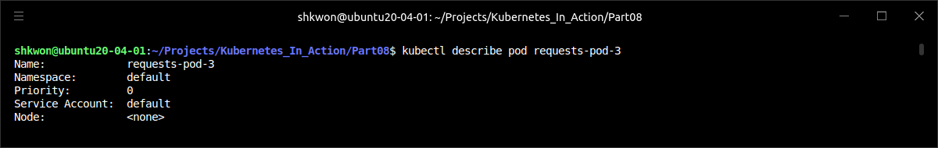
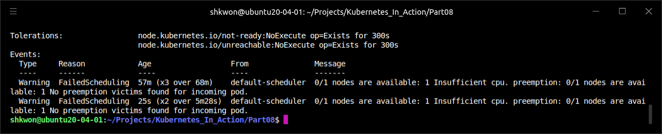
Requesting Resources for a Pod’s Containers(9/13)
Understanding How Resource Requests Affect Scheduling :
  Even if you wait a while, the pod is still stuck at “Pending”. You can see more information on why that’s the case by using the “$ kubectl describe pod” command, as shown in the following listing.
  The previous output shows that the pod hasn’t been scheduled because it can’t fit on any node due to insufficient CPU on your single node(Minikube). The sum of the CPU requests of all three pods equals 4,000 millicores or exactly four cores, which is exactly what your node can provide.

Slide 12
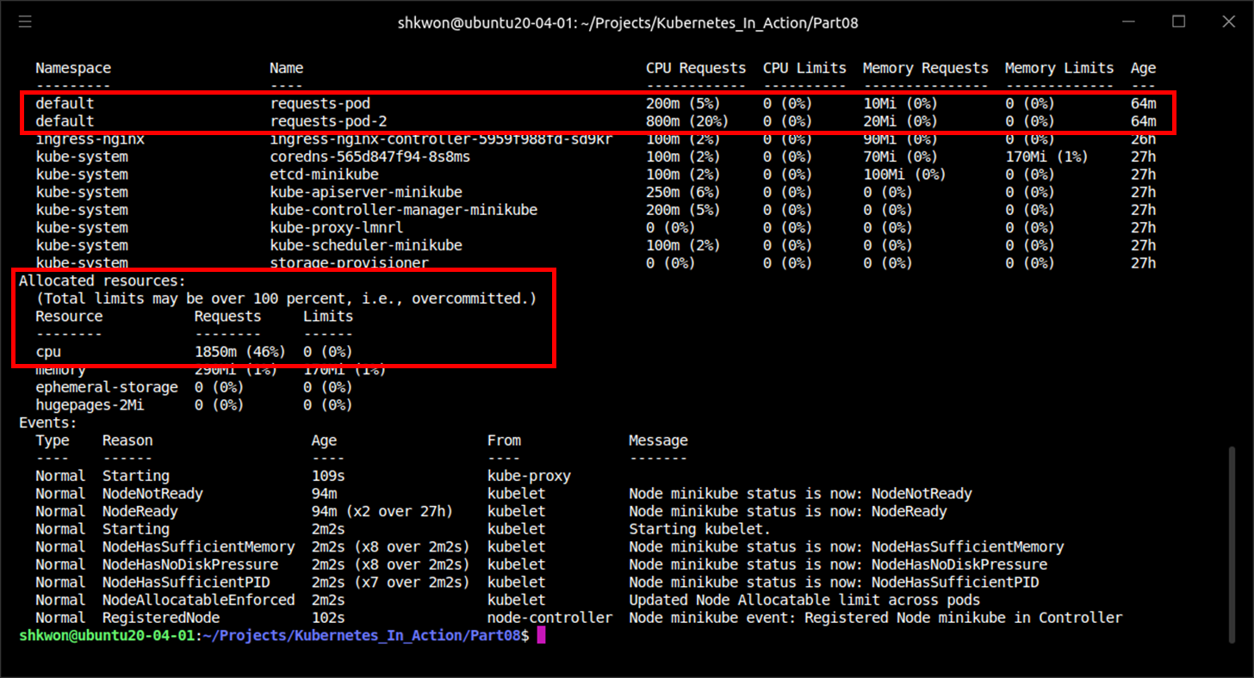
Requesting Resources for a Pod’s Containers(10/13)
Understanding How Resource Requests Affect Scheduling :
  You can figure out why the pod isn’t being scheduled by inspecting the node resource. Use the “$ kubectl describe node” command again and examine the output more closely in the following listing.

Slide 13
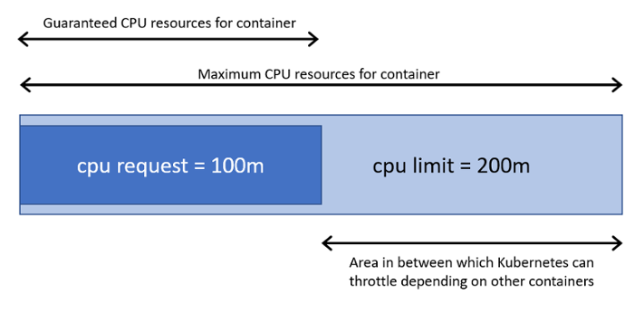
Requesting Resources for a Pod’s Containers(11/13)
Understanding How Resource Requests Affect Scheduling :
  If you look at the bottom left of the previous screenshot, you’ll see a total of 1,850 millicores have been requested by the running pods, which is 850 millicores more than what you requested for the first two pods you deployed. Something is eating up additional CPU resources.
  You can find the culprit in the list of pods in the previous screenshot. Seven pods in the kube-system namespace have explicitly requested CPU resources. Those pods plus your two pods leave only 2,150(4,000-1,850) millicores available for additional pods. Because your third pod requested 3,000 millicores, the Scheduler won’t schedule it to this node, as that would make the node overcommitted.
  The pod will only be scheduled when an adequate amount of CPU is freed (when one of the first two pods is deleted, for example). If you delete your first and second pod, the Scheduler will be notified of the deletion (through the watch mechanism described before) and will schedule your third pod as soon as the second pod terminates. (200 + 800 + 2,150 > 3,000)

Slide 14
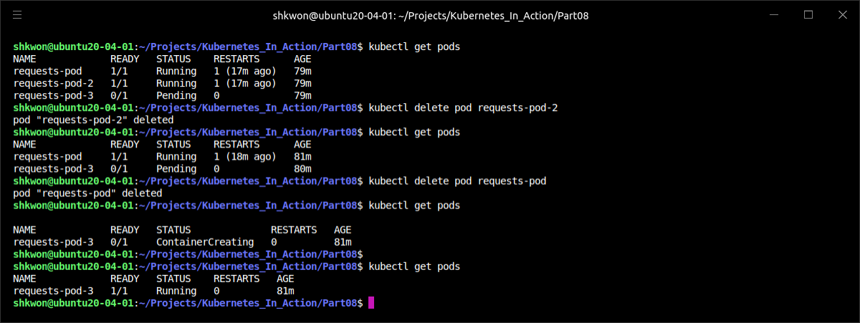
Requesting Resources for a Pod’s Containers(12/13)
Understanding How Resource Requests Affect Scheduling :
  In all these examples, you’ve specified a request for memory, but it hasn’t played any role in the scheduling because your node has more than enough allocatable memory to accommodate all your pods’ requests. Both CPU and memory requests are treated the same way by the Scheduler, but in contrast to memory requests, a pod’s CPU requests also play a role elsewhere—while the pod is running.
$ kubectl delete pod requests-pod-2
$ kubectl delete pod requests-pod

Slide 15
Requesting Resources for a Pod’s Containers(13/13)
Understanding How CPU Requests Affect CPU Time Sharing :
  Kubernetes distinguishes between resource requests and limits. You haven’t defined any limits yet, so the two pods(“requests-pod, requests-pod-3”) are in no way limited when it comes to how much CPU they can each consume. If the process inside each pod consumes as much CPU time as it can, how much CPU time does each pod get?
  The CPU requests don’t only affect scheduling—they also determine how the remaining (unused) CPU time is distributed between pods. Because your first pod requested “200 millicores” of CPU and the other one(“request-pod-3”) “1,000 millicores”, any unused CPU will be split among the two pods in a 1 to 5 ratio, as shown in the following figure. If both pods consume as much CPU as they can, the first pod will get one sixth(1/6) or 16.7% of the CPU time and the other one the remaining five sixths(5/6) or 83.3%.
  But if one container wants to use up as much CPU as it can, while the other one is sitting idle at a given moment, the first container will be allowed to use the whole CPU time (minus the small amount of time used by the second container, if any). After all, it makes sense to use all the available CPU if no one else is using it, right? As soon as the second container needs CPU time, it will get it and the first container will be throttled back.

Slide 16
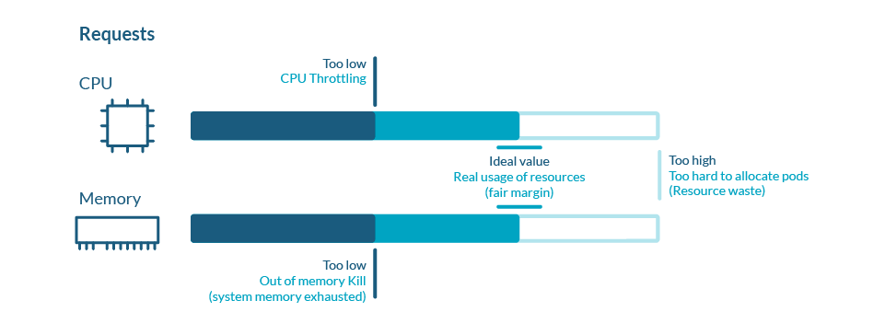
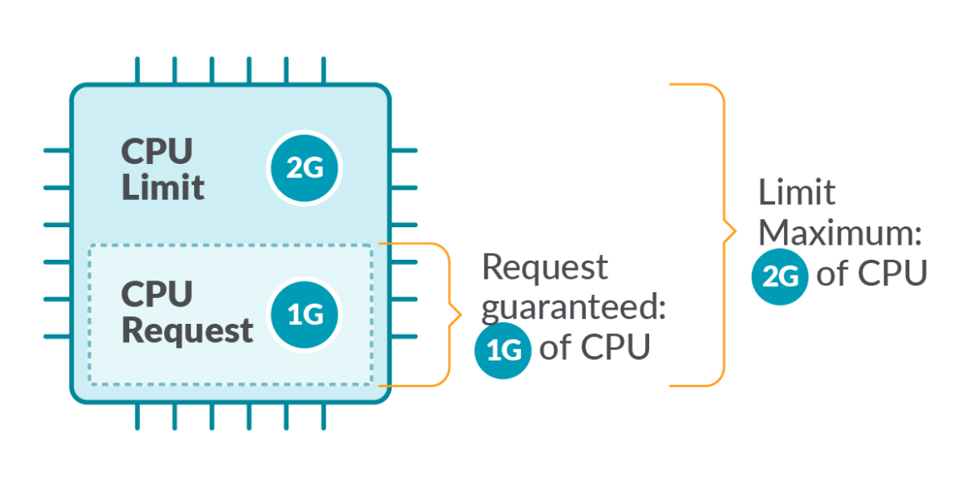
Limiting Resources Available to a Container(1/9)
Setting a Hard Limit for the Amount of Resources a Container Can Use :
  Setting resource requests for containers in a pod ensures each container gets the minimum amount of resources it needs.
  We’ve seen how containers are allowed to use up all the CPU if all the other processes are sitting idle. But you may want to prevent certain containers from using up more than a specific amount of CPU. And you’ll always want to limit the amount of memory a container can consume.
  CPU is a compressible resource, which means the amount used by a container can be throttled without affecting the process running in the container in an adverse way. Memory is obviously different—it’s incompressible. Once a process is given a chunk of memory, that memory can’t be taken away from it until it’s released by the process itself. That’s why you need to limit the maximum amount of memory a container can be given.
  Without limiting memory, a container (or a pod) running on a worker node may eat up all the available memory and affect all other pods on the node and any new pods scheduled to the node (remember that new pods are scheduled to the node based on the memory requests and not actual memory usage). A single malfunctioning or malicious pod can practically make the whole node unusable.

Slide 17
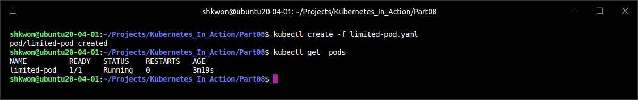
Limiting Resources Available to a Container(2/9)
Setting a Hard Limit for the Amount of Resources a Container Can Use :
  Kubernetes allows you to specify resource limits for every container (along with, and virtually in the same way as, resource requests). The following listing shows an example pod manifest with resource limits.
  The above pod’s container has resource limits configured for both CPU and memory. The process or processes running inside the container will not be allowed to consume more than 1 CPU core and 20 mebibytes of memory. Because you haven’t specified any resource requests, they’ll be set to the same values as the resource limits.
apiVersion: v1
kind: Pod
metadata:
name: limited-pod
spec:
containers:
- image: busybox
command: ["dd", "if=/dev/zero", "of=/dev/null"]
name: main
resources:
limits:
cpu: 1
memory: 20Mi
limited-pod.yaml

Slide 18
Limiting Resources Available to a Container(3/9)
Setting a Hard Limit for the Amount of Resources a Container Can Use :
  Unlike resource requests, resource limits aren’t constrained by the node’s allocatable resource amounts. The sum of all limits of all the pods on a node is allowed to exceed 100% of the node’s capacity (See the following figure). Restated, resource limits can be overcommitted.
  This has an important consequence—when 100% of the node’s resources are used up, certain containers will need to be killed.
  You’ll see how Kubernetes decides which containers to kill, but individual containers can be killed even if they try to use more than their resource limits specify.

Slide 19
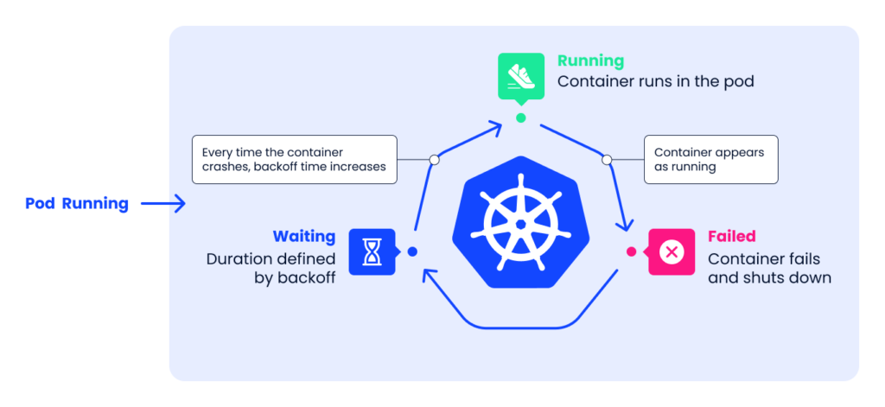
Limiting Resources Available to a Container(4/9)
Exceeding the Limits :
  What happens when a process running in a container tries to use a greater amount of resources than it’s allowed to?
  You’ve already learned that CPU is a compressible resource, and it’s only natural for a process to want to consume all of the CPU time when not waiting for an I/O operation. As you’ve learned, a process’ CPU usage is throttled, so when a CPU limit is set for a container, the process isn’t given more CPU time than the configured limit.
  With memory, it’s different. When a process tries to allocate memory over its limit, the process is killed (it’s said the container is OOMKilled(OOM : “Out Of Memory”). If the pod’s restart policy is set to “Always” or “OnFailure”, the process is restarted immediately, so you may not even notice it getting killed. But if it keeps going over the memory limit and getting killed, Kubernetes will begin restarting it with increasing delays between restarts. You’ll see a “CrashLoopBackOff” status in that case.
  The “CrashLoopBackOff” status doesn’t mean the Kubelet has given up. It means that after each crash, the Kubelet is increasing the time period before restarting the container. After the first crash, it restarts the container immediately and then, if it crashes again, waits for 10 seconds before restarting it again. On subsequent crashes, this delay is then increased exponentially to 20, 40, 80, and 160 seconds, and finally limited to 300 seconds. Once the interval hits the 300-second limit, the Kubelet keeps restarting the container indefinitely every five minutes until the pod either stops crashing or is deleted.

Slide 20
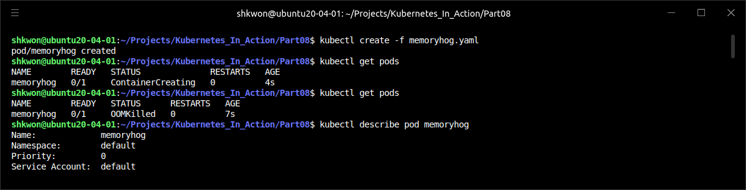
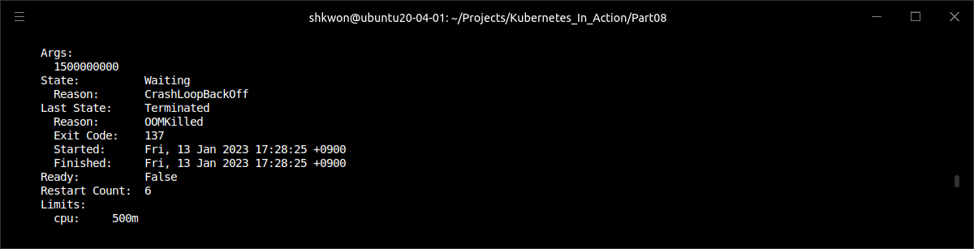
Limiting Resources Available to a Container(5/9)
Exceeding the Limits :
  To examine why the container crashed, you can check the pod’s log and/or use the “$ kubectl describe pod” command, as shown in the following listing.

Slide 21
Limiting Resources Available to a Container(6/9)
Exceeding the Limits :
  The OOMKilled status tells you that the container was killed because it was out of memory. In the previous screenshot, the container went over its memory limit and was killed immediately.
  It’s important not to set memory limits too low if you don’t want your container to be killed. But containers can get OOMKilled even if they aren’t over their limit.

Slide 22
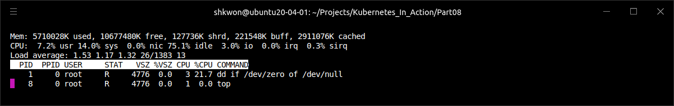
Limiting Resources Available to a Container(7/9)
Understanding How Apps in Containers See Limits :
  If you haven’t deployed the pod(“limited-pod.yaml”), deploy it now. Then, run the “top” command in the container. The command’s output is shown in the following screenshot.
  The pod’s CPU limit is set to 1 core and its memory limit is set to 20 MiB. Now, examine the output of the top command closely. Is there anything that strikes you as odd?
  Look at the amount of used and free memory. Those numbers are nowhere near the 20 MiB you set as the limit for the container. Similarly, you set the CPU limit to one core and it seems like the main process is using only 22% of the available CPU time, even though the “dd” command, when used like you’re using it, usually uses all the CPU it has available. What’s going on?
$ kubectl create -f limited-pod.yaml
$ kubectl exec -it limited-pod -- top

Slide 23
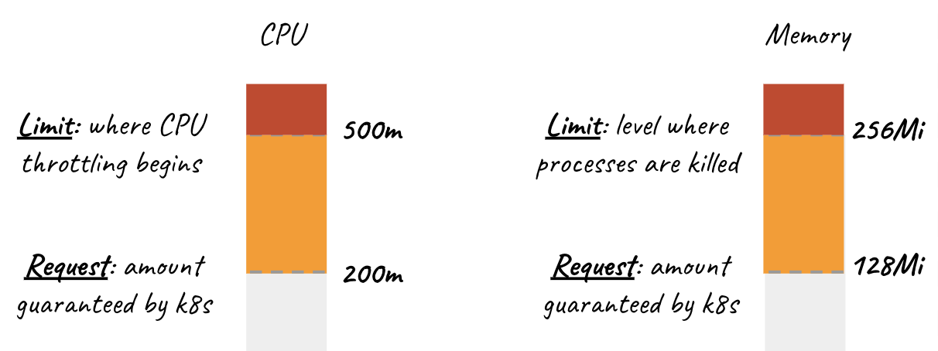
Limiting Resources Available to a Container(8/9)
Understanding How Apps in Containers See Limits :
  The “top” command shows the memory amounts of the whole node the container is running on. Even though you set a limit on how much memory is available to a container, the container will not be aware of this limit.
  This has an unfortunate effect on any application that looks up the amount of memory available on the system and uses that information to decide how much memory it wants to reserve.
  The problem is visible when running Java apps, especially if you don’t specify the maximum heap size for the Java Virtual Machine(JVM) with the “-Xmx” option. In that case, the JVM will set the maximum heap size based on the host’s total memory instead of the memory available to the container. When you run your containerized Java apps in a Kubernetes cluster on your laptop, the problem doesn’t manifest itself, because the difference between the memory limits you set for the pod and the total memory available on your laptop is not that great.
  But when you deploy your pod onto a production system, where nodes have much more physical memory, the JVM may go over the container’s memory limit you configured and will be OOMKilled.
  And if you think setting the “-Xmx” option properly solves the issue, you’re wrong, unfortunately. The “-Xmx” option only constrains the heap size, but does nothing about the JVM’s off-heap memory. Luckily, new versions of Java alleviate that problem by taking the configured container limits into account.

Slide 24
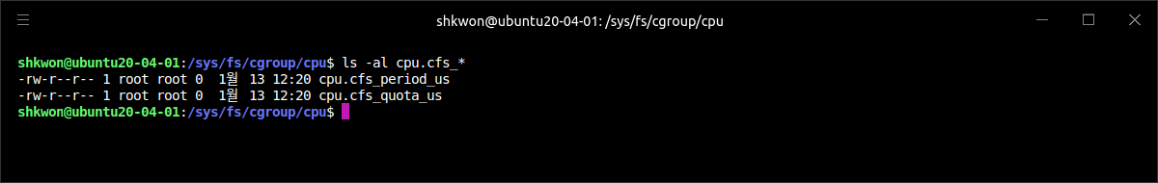
Limiting Resources Available to a Container(9/9)
Understanding How Apps in Containers See Limits :
  Exactly like with memory, containers will also see all the node’s CPUs, regardless of the CPU limits configured for the container. Setting a CPU limit to one core doesn’t magically only expose only one CPU core to the container. All the CPU limit does is constrain the amount of CPU time the container can use.
  A container with a one-core CPU limit running on a 64-core CPU will get 1/64th of the overall CPU time. And even though its limit is set to one core, the container’s processes will not run on only one core. At different points in time, its code may be executed on different cores.
  Certain applications look up the number of CPUs on the system to decide how many worker threads they should run. Again, such an app will run fine on a development laptop, but when deployed on a node with a much bigger number of cores, it’s going to spin up too many threads, all competing for the (possibly) limited CPU time. Also, each thread requires additional memory, causing the apps memory usage to skyrocket.
  You may want to use the “Downward API” to pass the CPU limit to the container and use it instead of relying on the number of CPUs your app can see on the system. You can also tap into the “cgroups” system directly to get the configured CPU limit by reading the following files :
    /sys/fs/cgroup/cpu/cpu.cfs_quota_us
    /sys/fs/cgroup/cpu/cpu.cfs_period_us

Slide 25
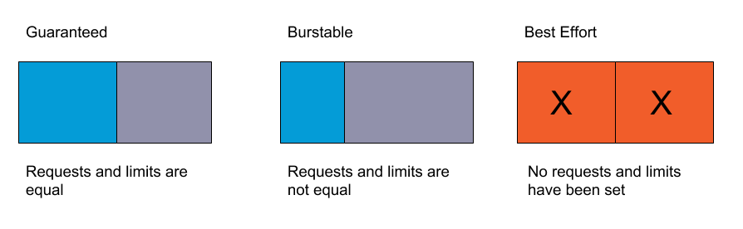
Understanding Pod QoS Classes(1/7)
QoS(Quality of Service) :
  Imagine having two pods, where pod A is using, let’s say, 90% of the node’s memory and then pod B suddenly requires more memory than what it had been using up to that point and the node can’t provide the required amount of memory. Which container should be killed? Should it be pod B, because its request for memory can’t be satisfied, or should pod A be killed to free up memory, so it can be provided to pod B?
  Kubernetes can’t make a proper decision on its own. You need a way to specify which pods have priority in such cases. Kubernetes does this by categorizing pods into three “Quality of Service (QoS)” classes :
    BestEffort (the lowest priority)
    Burstable
    Guaranteed (the highest).

Slide 26
Understanding Pod QoS Classes(2/7)
Defining the QoS Class for a Pod :
  You might expect these classes to be assignable to pods through a separate field in the manifest, but they aren’t. The QoS class is derived from the combination of resource requests and limits for the pod’s containers.
  The lowest priority QoS class is the BestEffort class. It’s assigned to pods that don’t have any requests or limits set at all (in any of their containers). This is the QoS class that has been assigned to all the pods. Containers running in these pods have had no resource guarantees whatsoever. In the worst case, they may get almost no CPU time at all and will be the first ones killed when memory needs to be freed for other pods. But because a BestEffort pod has no memory limits set, its containers may use as much memory as they want, if enough memory is available.
  On the other end of the spectrum is the Guaranteed QoS class. This class is given to pods whose containers’ requests are equal to the limits for all resources. For a pod’s class to be Guaranteed, three things need to be true :
    Requests and limits need to be set for both CPU and memory.
    They need to be set for each container.
    They need to be equal (the limit needs to match the request for each resource in each container).
  Because a container’s resource requests, if not set explicitly, default to the limits, specifying the limits for all resources (for each container in the pod) is enough for the pod to be Guaranteed. Containers in those pods get the requested amount of resources, but cannot consume additional ones (because their limits are no higher than their requests).

Slide 27
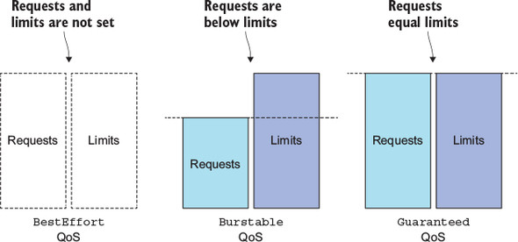
Understanding Pod QoS Classes(3/7)
Defining the QoS Class for a Pod :
  In between BestEffort and Guaranteed is the Burstable QoS class. All other pods fall into this class. This includes single-container pods where the container’s limits don’t match its requests and all pods where at least one container has a resource request specified, but not the limit. It also includes pods where one container’s requests match their limits, but another container has no requests or limits specified. Burstable pods get the amount of resources they request, but are allowed to use additional resources (up to the limit) if needed.
  All three QoS classes and their relationships with requests and limits are shown in the following figure.
  Thinking about what QoS class a pod has can make your head spin, because it involves multiple containers, multiple resources, and all the possible relationships between requests and limits. It’s easier if you start by thinking about QoS at the container level (although QoS classes are a property of pods, not containers) and then derive the pod’s QoS class from the QoS classes of containers.

Slide 28
Understanding Pod QoS Classes(4/7)
Defining the QoS Class for a Pod :
  The following table shows the QoS class based on how resource requests and limits are defined on a single container. For single-container pods, the QoS class applies to the pod as well.
  NOTE : If only requests are set, but not limits, refer to the table rows where requests are less than the limits. If only limits are set, requests default to the limits, so refer to the rows where requests equal limits.

Slide 29
Understanding Pod QoS Classes(5/7)
Defining the QoS Class for a Pod :
  For multi-container pods, if all the containers have the same QoS class, that’s also the pod’s QoS class. If at least one container has a different class, the pod’s QoS class is Burstable, regardless of what the container classes are. The following table shows how a two-container pod’s QoS class relates to the classes of its two containers. You can easily extend this to pods with more than two containers.
  NOTE : A pod’s QoS class is shown when running “$ kubectl describe pod” command and in the pod’s YAML/JSON manifest in the “status.qosClass” field.

Slide 30
Understanding Pod QoS Classes(6/7)
Understanding Which Process Gets Killed When Memory Is Low :
  When the system is overcommitted, the QoS classes determine which container gets killed first so the freed resources can be given to higher priority pods. First in line to get killed are pods in the BestEffort class, followed by Burstable pods, and finally Guaranteed pods, which only get killed if system processes need memory.
  Let’s look at the example shown in the following figure. Imagine having two single-container pods, where the first one has the BestEffort QoS class, and the second one’s is Burstable. When the node’s whole memory is already maxed out and one of the processes on the node tries to allocate more memory, the system will need to kill one of the processes (perhaps even the process trying to allocate additional memory) to honor the allocation request. In this case, the process running in the BestEffort pod will always be killed before the one in the Burstable pod.
  Obviously, a BestEffort pod’s process will also be killed before any Guaranteed pods’ processes are killed. Likewise, a Burstable pod’s process will also be killed before that of a Guaranteed pod. But what happens if there are only two Burstable pods? Clearly, the selection process needs to prefer one over the other.

Slide 31
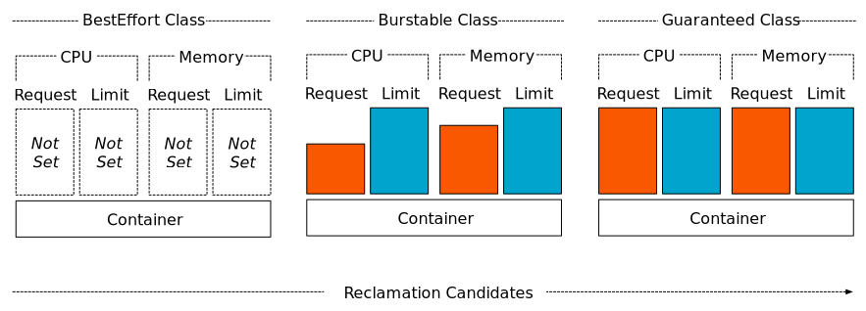
Understanding Pod QoS Classes(7/7)
Understanding Which Process Gets Killed When Memory Is Low :
  Each running process has an OutOfMemory (OOM) score. The system selects the process to kill by comparing OOM scores of all the running processes. When memory needs to be freed, the process with the highest score gets killed.
  OOM scores are calculated from two things : the percentage of the available memory the process is consuming and a fixed OOM score adjustment, which is based on the pod’s QoS class and the container’s requested memory. When two single-container pods exist, both in the Burstable class, the system will kill the one using more of its requested memory than the other, percentage-wise. That’s why in the previous figure, pod B, using 90% of its requested memory, gets killed before pod C, which is only using 70%, even though it’s using more megabytes of memory than pod B.
  This shows you need to be mindful of not only the relationship between requests and limits, but also of requests and the expected actual memory consumption.

Slide 32
Setting Default Requests and Limits for Pods Per Namespace(1/7)
LimitRange Resource :
  We’ve looked at how resource requests and limits can be set for each individual container. If you don’t set them, the container is at the mercy of all other containers that do specify resource requests and limits. It’s a good idea to set requests and limits on every container.
  Instead of having to do this for every container, you can also do it by creating a “LimitRange“ resource. It allows you to specify (for each namespace) not only the minimum and maximum limit you can set on a container for each resource, but also the default resource requests for containers that don’t specify requests explicitly, as depicted in the following figure.

Slide 33
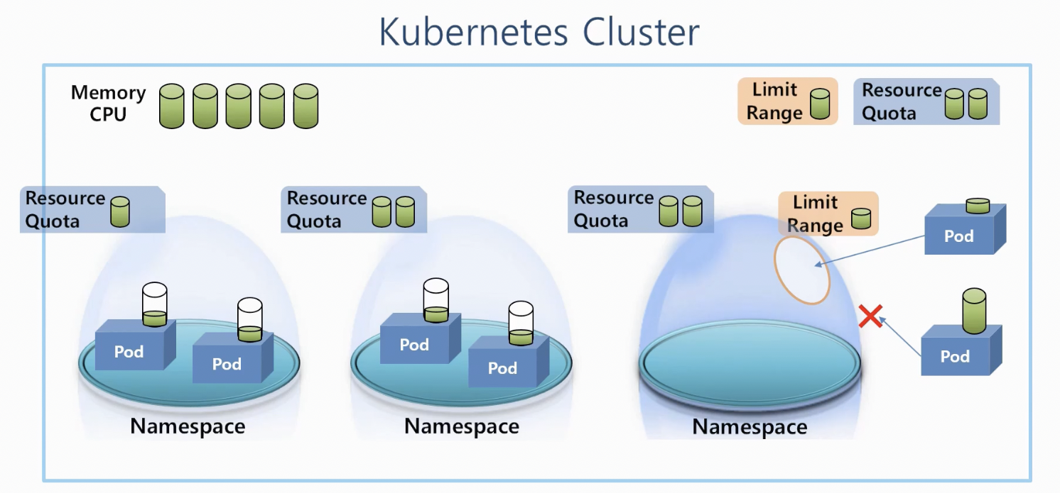
Setting Default Requests and Limits for Pods Per Namespace(2/7)
LimitRange Resource :
  LimitRange resources are used by the “LimitRanger Admission Control” plugin. When a pod manifest is posted to the API server, the LimitRanger plugin validates the pod spec. If validation fails, the manifest is rejected immediately. Because of this, a great use-case for LimitRange objects is to prevent users from creating pods that are bigger than any node in the cluster. Without such a LimitRange, the API server will gladly accept the pod, but then never schedule it.
  The limits specified in a LimitRange resource apply to each individual pod/container or other kind of object created in the same namespace as the LimitRange object. They don’t limit the total amount of resources available across all the pods in the namespace. This is specified through “ResourceQuota” objects.
  For more information, you can refer to https://kubernetes.io/docs/concepts/policy/limit-range/.

Slide 34
Setting Default Requests and Limits for Pods Per Namespace(3/7)
Creating a LimitRange Object :
  Let’s look at a full example of a LimitRange and see what the individual properties do. The following listing shows the full definition of a LimitRange resource.
  As you can see from the above example, the minimum and maximum limits for a whole pod can be configured. They apply to the sum of all the pod’s containers’ requests and limits.
  Lower down, at the container level, you can set not only the minimum and maximum, but also default resource requests (defaultRequest) and default limits (default) that will be applied to each container that doesn’t specify them explicitly.
apiVersion: v1
kind: LimitRange
metadata:
name: example
spec:
limits:
- type: Pod
min:
cpu: 50m
memory: 5Mi
max:
cpu: 1
memory: 1Gi
- type: Container
defaultRequest:
cpu: 100m
memory: 10Mi
limits.yaml
default:
cpu: 200m
memory: 100Mi
min:
cpu: 50m
memory: 5Mi
max:
cpu: 1
memory: 1Gi
maxLimitRequestRatio:
cpu: 4
memory: 10
- type: PersistentVolumeClaim
min:
storage: 1Gi
max:
storage: 10Gi

Slide 35
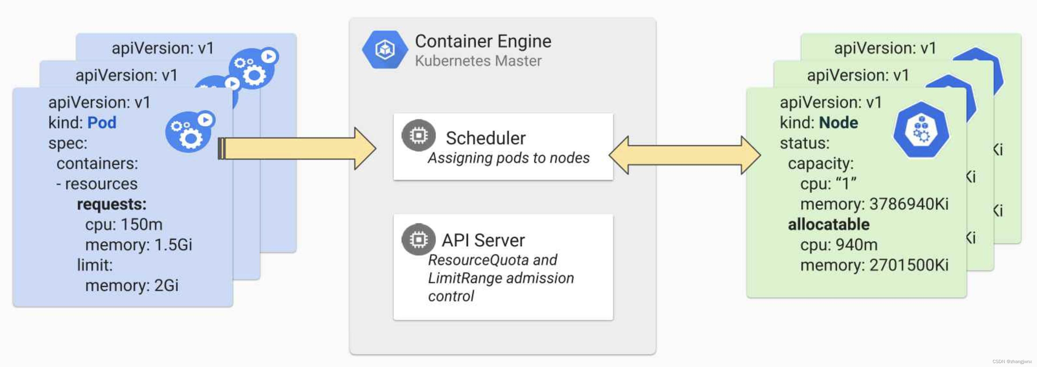
Setting Default Requests and Limits for Pods Per Namespace(4/7)
Creating a LimitRange Object :
  Beside the min, max, and default values, you can even set the maximum ratio of limits vs. requests. The previous listing sets the CPU “maxLimitRequestRatio” to 4, which means a container’s CPU limits will not be allowed to be more than four times greater than its CPU requests. A container requesting 200 millicores will not be accepted if its CPU limit is set to 801 millicores or higher. For memory, the maximum ratio is set to 10.
  PersistentVolumeClaims (PVC) allow you to claim a certain amount of persistent storage similarly to how a pod’s containers claim CPU and memory. In the same way you’re limiting the minimum and maximum amount of CPU a container can request, you should also limit the amount of storage a single PVC can request.
  The example shows a single LimitRange object containing limits for everything, but you could also split them into multiple objects if you prefer to have them organized per type (one for pod limits, another for container limits, and yet another for PVCs, for example). Limits from multiple LimitRange objects are all consolidated when validating a pod or PVC.
  Because the validation (and defaults) configured in a LimitRange object is performed by the API server when it receives a new pod or PVC manifest, if you modify the limits afterwards, existing pods and PVCs will not be revalidated—the new limits will only apply to pods and PVCs created afterward.

Slide 36
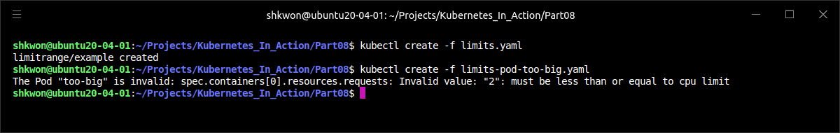
Setting Default Requests and Limits for Pods Per Namespace(5/7)
Enforcing the Limits :
  With your limits in place, you can now try creating a pod that requests more CPU than allowed by the LimitRange.
  NOTE : The pod’s single container is requesting two CPUs, which is more than the maximum you set in the LimitRange earlier. Creating the pod yields the above result.
apiVersion: v1
kind: Pod
metadata:
name: too-big
spec:
containers:
- image: busybox
args: ["sleep", "9999999"]
name: main
resources:
requests:
cpu: 2
limits-pod-too-big.yaml

Slide 37
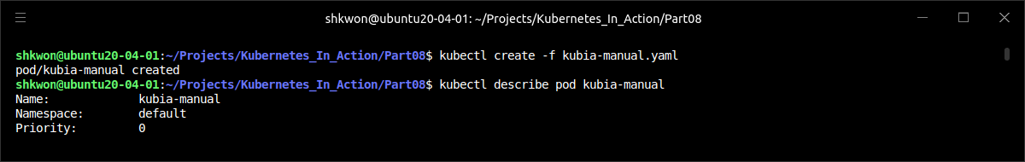
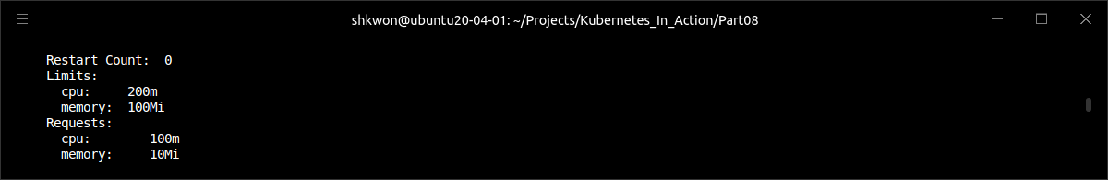
Setting Default Requests and Limits for Pods Per Namespace(6/7)
Applying Default Resource Requests and Limits :
  Now let’s also see how default resource requests and limits are set on containers that don’t specify them. Deploy the “kubia-manual” pod again :
  Before you set up your LimitRange object, all your pods were created without any resource requests or limits, but now the defaults are applied automatically when creating the pod. You can confirm this by describing the “kubia-manual” pod, as shown in the following listing.
$ kubectl create -f kubia-manual.yaml

Slide 38
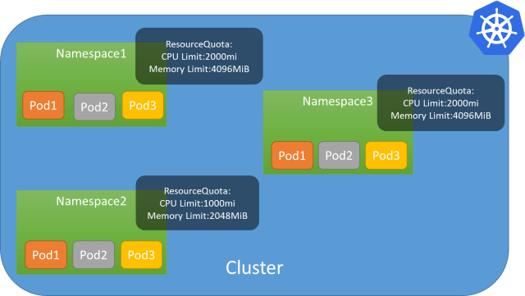
Setting Default Requests and Limits for Pods Per Namespace(7/7)
Applying Default Resource Requests and Limits :
  The container’s requests and limits match the ones you specified in the LimitRange object. If you used a different LimitRange specification in another namespace, pods created in that namespace would obviously have different requests and limits. This allows admins to configure default, min, and max resources for pods per namespace.
  If namespaces are used to separate different teams or to separate development, QA, staging, and production pods running in the same Kubernetes cluster, using a different LimitRange in each namespace ensures large pods can only be created in certain namespaces, whereas others are constrained to smaller pods.
  But remember, the limits configured in a LimitRange only apply to each individual pod/container. It’s still possible to create many pods and eat up all the resources available in the cluster. LimitRanges don’t provide any protection from that. A ResourceQuota object, on the other hand, does.

Slide 39
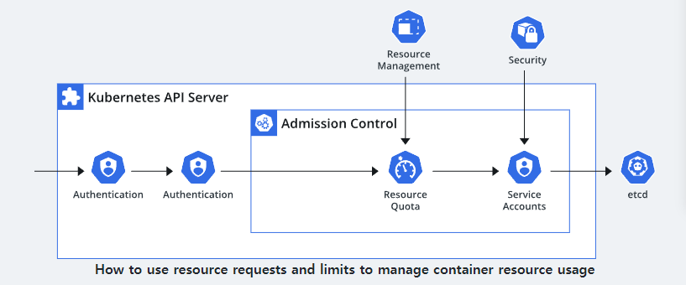
Limiting the Total Resources Available in a Namespace(1/12)
ResourceQuota Object :
  The LimitRanges only apply to individual pods, but cluster admins also need a way to limit the total amount of resources available in a namespace. This is achieved by creating a ResourceQuota object.
  Several Admission Control plugins running inside the API server verify whether the pod may be created or not. The LimitRanger plugin enforces the policies configured in LimitRange resources. Similarly, the ResourceQuota Admission Control plugin checks whether the pod being created would cause the configured ResourceQuota to be exceeded. If that’s the case, the pod’s creation is rejected. Because resource quotas are enforced at pod creation time, a ResourceQuota object only affects pods created after the ResourceQuota object is created—creating it has no effect on existing pods.
  A ResourceQuota limits the amount of computational resources the pods and the amount of storage PersistentVolumeClaims in a namespace can consume. It can also limit the number of pods, claims, and other API objects users are allowed to create inside the namespace.

Slide 40
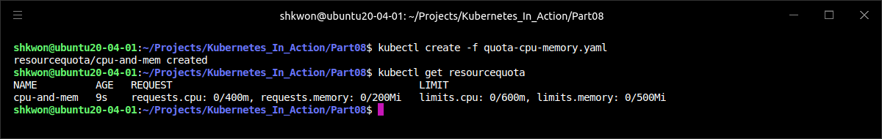
Limiting the Total Resources Available in a Namespace(2/12)
ResourceQuota Object :
  The overall CPU and memory all the pods in a namespace are allowed to consume is defined by creating a ResourceQuota object as shown in the following listing.
  Instead of defining a single total for each resource, you define separate totals for requests and limits for both CPU and memory. You’ll notice the structure is a bit different, compared to that of a LimitRange. Here, both the requests and the limits for all resources are defined in a single place.
apiVersion: v1
kind: ResourceQuota
metadata:
name: cpu-and-mem
spec:
hard:
requests.cpu: 400m
requests.memory: 200Mi
limits.cpu: 600m
limits.memory: 500Mi
quota-cpu-memory.yaml

Slide 41
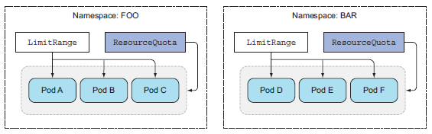
Limiting the Total Resources Available in a Namespace(3/12)
ResourceQuota Object :
  In the previous example, the ResourceQuota sets the maximum amount of CPU pods in the namespace can request to 400 millicores. The maximum total CPU limits in the namespace are set to 600 millicores. For memory, the maximum total requests are set to 200 MiB, whereas the limits are set to 500 MiB.
  A ResourceQuota object applies to the namespace it’s created in, like a LimitRange, but it applies to all the pods’ resource requests and limits in total and not to each individual pod or container separately, as shown in the following figure.

Slide 42
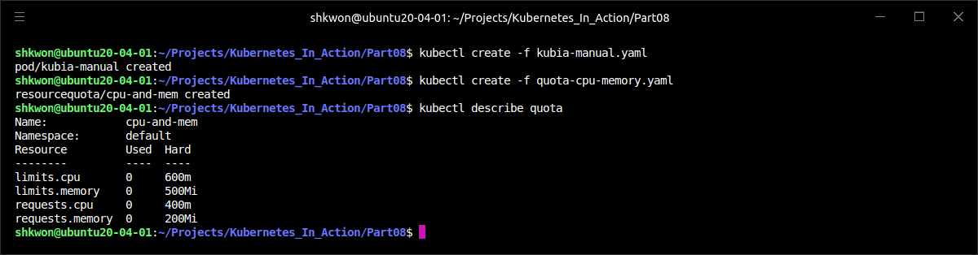
Limiting the Total Resources Available in a Namespace(4/12)
ResourceQuota Object :
  After you post the ResourceQuota object to the API server, you can use the “$ kubectl describe” command to see how much of the quota is already used up, as shown in the following screenshot.
  The “kubia-manual” pod is already running without requesting CPU or memory resources, so the Used column matches its resource requests and limits(it is zero now). When we run additional pods, their requests and limits are added to the used amounts.
$ kubectl describe quota

Slide 43
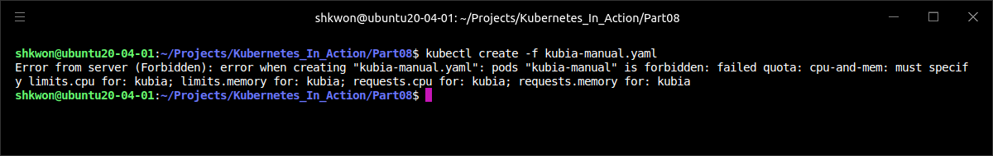
Limiting the Total Resources Available in a Namespace(5/12)
ResourceQuota Object :
  One caveat when creating a ResourceQuota is that you will also want to create a LimitRange object alongside it. In your case, you have a LimitRange configured from the previous section, but if you didn’t have one, you couldn’t run the “kubia-manual” pod, because it doesn’t specify any resource requests or limits. Here’s what would happen in that case :
  When a quota for a specific resource (CPU or memory) is configured (request or limit), pods need to have the request or limit (respectively) set for that same resource; otherwise the API server will not accept the pod. That’s why having a LimitRange with defaults for those resources can make life a bit easier for people creating pods.
$ kubectl create -f kubia-manual.yaml

Slide 44
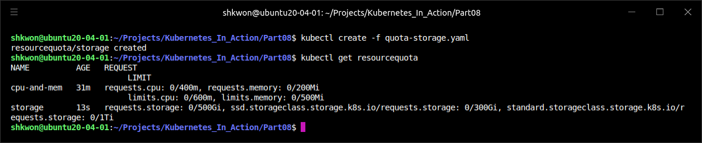
Limiting the Total Resources Available in a Namespace(6/12)
Specifying a Quota for Persistent Storage :
  A ResourceQuota object can also limit the amount of persistent storage that can be claimed in the namespace, as shown in the following listing.
apiVersion: v1
kind: ResourceQuota
metadata:
name: storage
spec:
hard:
requests.storage: 500Gi
ssd.storageclass.storage.k8s.io/requests.storage: 300Gi
standard.storageclass.storage.k8s.io/requests.storage: 1Ti
quota-storage.yaml

Slide 45
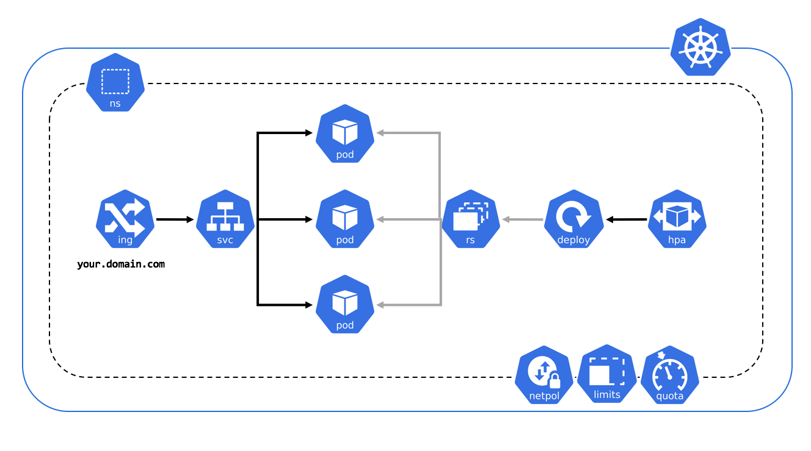
Limiting the Total Resources Available in a Namespace(7/12)
Specifying a Quota for Persistent Storage :
  In the previous example, the amount of storage all PersistentVolumeClaims in a namespace can request is limited to 500 GiB (by the “requests.storage” entry in the ResourceQuota object). But PersistentVolumeClaims can request a dynamically provisioned PersistentVolume of a specific StorageClass. That’s why Kubernetes also makes it possible to define storage quotas for each StorageClass individually. The previous example limits the total amount of claimable SSD storage (designated by the ssd StorageClass) to 300 GiB. The less-performant HDD storage (StorageClass standard) is limited to 1 TiB.

Slide 46
Limiting the Total Resources Available in a Namespace(8/12)
Limiting the Number of Objects That Can Be Created :
  A ResourceQuota can also be configured to limit the number of Pods, ReplicationControllers, Services, and other objects inside a single namespace. This allows the cluster admin to limit the number of objects users can create based on their payment plan, for example, and can also limit the number of public IPs or node ports Services can use. The following listing shows what a ResourceQuota object that limits the number of objects may look like.
apiVersion: v1
kind: ResourceQuota
metadata:
name: objects
spec:
hard:
pods: 10
replicationcontrollers: 5
secrets: 10
configmaps: 10
persistentvolumeclaims: 5
services: 5
services.loadbalancers: 1
services.nodeports: 2
ssd.storageclass.storage.k8s.io/persistentvolumeclaims: 2
quota-object-count.yaml

Slide 47
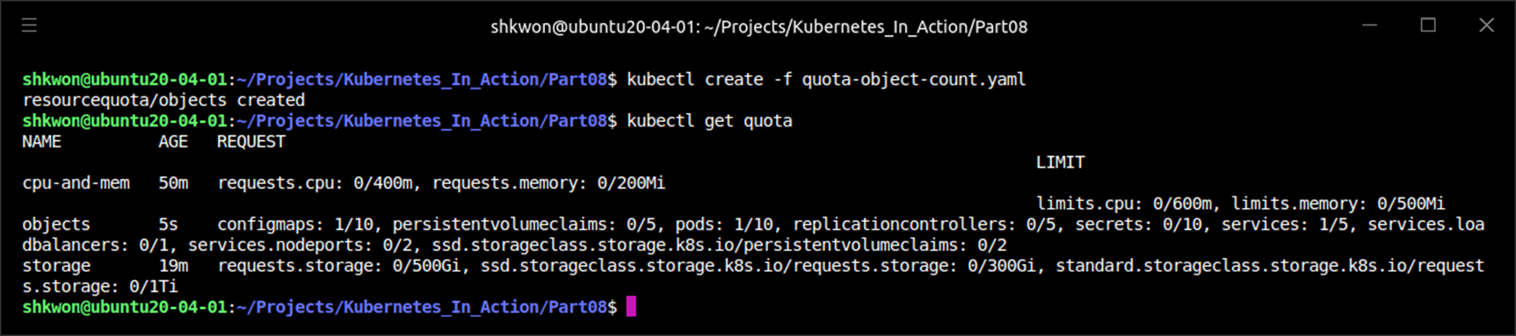
NOTE : Object Count Quota
Setting the Object Count Quota for Default Namespace :
  You can run the following command to create an Object Count Quota.
$ kubectl create -f quota-object-count.yaml

Slide 48
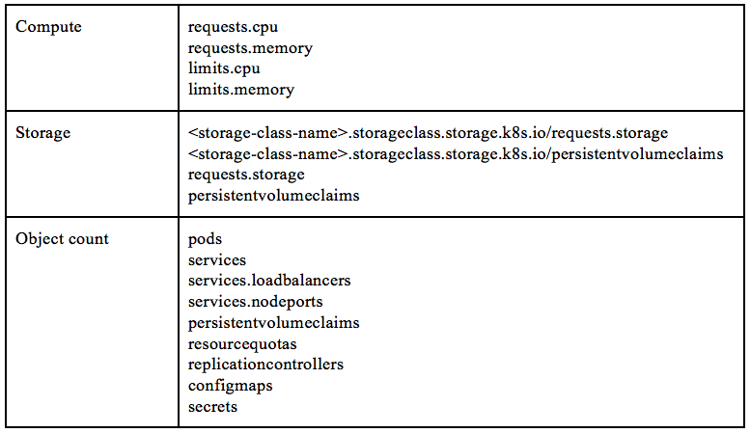
Limiting the Total Resources Available in a Namespace(9/12)
Limiting the Number of Objects That Can Be Created :
  The ResourceQuota in the previous listing allows users to create at most 10 Pods in the namespace, regardless if they’re created manually or by a ReplicationController, ReplicaSet, DaemonSet, Job, and so on. It also limits the number of ReplicationControllers to five. A maximum of five Services can be created, of which only one can be a LoadBalancer-type Service, and only two can be NodePort Services. Similar to how the maximum amount of requested storage can be specified per StorageClass, the number of PersistentVolumeClaims can also be limited per StorageClass. Object count quotas can currently be set for the following objects :
    Pods
    ReplicationControllers
    Secrets
    ConfigMaps
    PersistentVolumeClaims
    Services (in general), and for two specific types of Services, such as LoadBalancer Services (services.loadbalancers) and NodePort Services (services.nodeports)
  Finally, you can even set an object count quota for ResourceQuota objects themselves.
  For more information, refer to https://kubernetes.io/docs/concepts/policy/resource-quotas/.

Slide 49
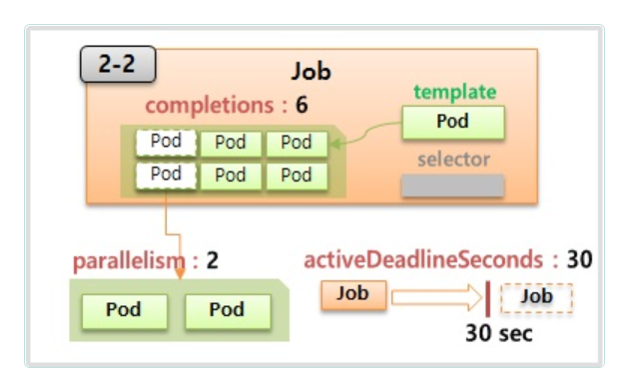
Limiting the Total Resources Available in a Namespace(10/12)
Specifying Quotas for Specific Pod States and/or QoS Classes :
  The quotas you’ve created so far have applied to all pods, regardless of their current state and QoS class. But quotas can also be limited to a set of quota scopes. Four scopes are currently available: BestEffort, NotBestEffort, Terminating, and NotTerminating.
  The BestEffort and NotBestEffort scopes determine whether the quota applies to pods with the BestEffort QoS class or with one of the other two classes (that is, Burstable and Guaranteed).
  The other two scopes (Terminating and NotTerminating) don’t apply to pods that are (or aren’t) in the process of shutting down. You can specify how long each pod is allowed to run before it’s terminated and marked as Failed. This is done by setting the “activeDeadlineSeconds” field in the pod spec. This property defines the number of seconds a pod is allowed to be active on the node relative to its start time before it’s marked as Failed and then terminated. The Terminating quota scope applies to pods that have the “activeDeadlineSeconds” set, whereas the NotTerminating applies to those that don’t.
  When creating a ResourceQuota, you can specify the scopes that it applies to. A pod must match all the specified scopes for the quota to apply to it. Additionally, what a quota can limit depends on the quota’s scope. BestEffort scope can only limit the number of pods, whereas the other three scopes can limit the number of pods, CPU/memory requests, and CPU/memory limits.

Slide 50
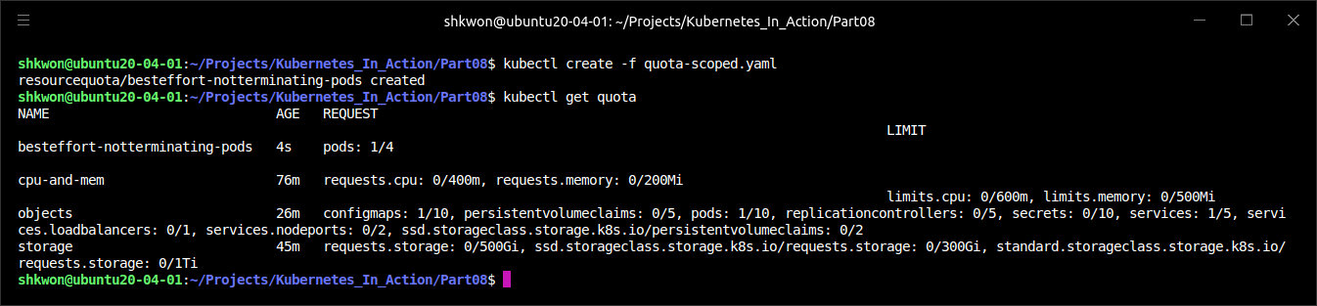
Limiting the Total Resources Available in a Namespace(11/12)
Specifying Quotas for Specific Pod States and/or QoS Classes :
  For example, if you want the quota to apply only to BestEffort, NotTerminating pods, you can create the ResourceQuota object shown in the following listing.
apiVersion: v1
kind: ResourceQuota
metadata:
name: besteffort-notterminating-pods
spec:
scopes:
- BestEffort
- NotTerminating
hard:
pods: 4
quota-scoped.yaml

Slide 51
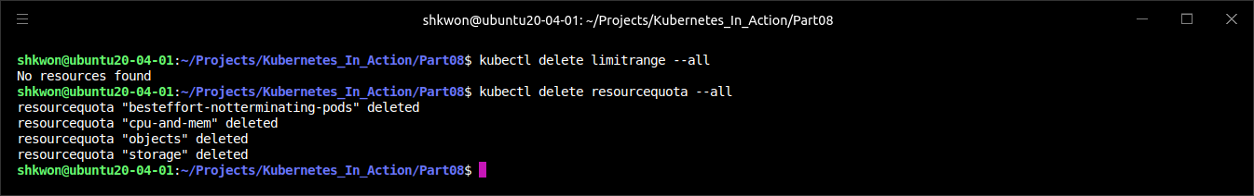
Limiting the Total Resources Available in a Namespace(12/12)
Specifying Quotas for Specific Pod States and/or QoS Classes :
  In the previous example, the quota ensures that at most four pods exist with the BestEffort QoS class, which don’t have an active deadline. If the quota was targeting NotBestEffort pods instead, you could also specify requests.cpu, requests.memory, limits.cpu, and limits.memory.
  NOTE : Please delete all the ResourceQuota and LimitRange resources you created. For this, you can use “$ kubectl delete limitrange --all” and “$ kubectl delete resourcequota --all” respectively.
$ kubectl delete limitrange --all
$ kubectl delete resourcequota --all

Slide 52
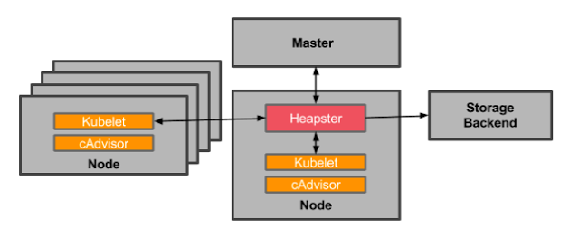
Monitoring Pod Resource Usage(1/8)
Collecting and Retrieving Actual Resource Usages :
  Properly setting resource requests and limits is crucial for getting the most out of your Kubernetes cluster. If requests are set too high, your cluster nodes will be underutilized and you’ll be throwing money away. If you set them too low, your apps will be CPU-starved or even killed by the OOM Killer.
  You can find the sweet spot by monitoring the actual resource usage of your containers under the expected load levels. Once the application is exposed to the public, you should keep monitoring it and adjust the resource requests and limits if required.
  The Kubelet itself already contains an agent called cAdvisor, which performs the basic collection of resource consumption data for both individual containers running on the node and the node as a whole. Gathering those statistics centrally for the whole cluster requires you to run an additional component called Heapster.

Slide 53
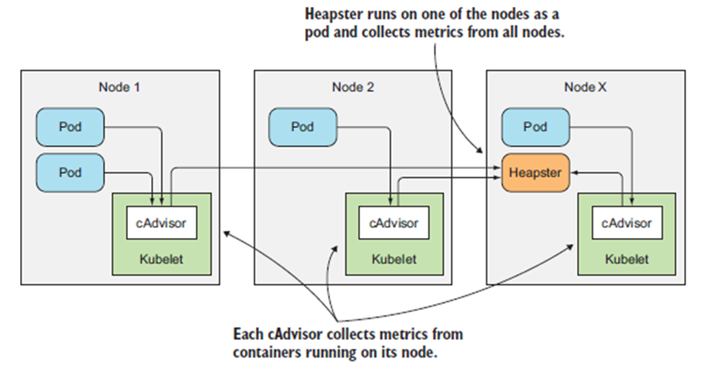
Monitoring Pod Resource Usage(2/8)
Collecting and Retrieving Actual Resource Usages :
  Heapster runs as a pod on one of the nodes and is exposed through a regular Kubernetes Service, making it accessible at a stable IP address. It collects the data from all cAdvisors in the cluster and exposes it in a single location. The following figure shows the flow of the metrics data from the pods, through cAdvisor and finally into Heapster.
  The arrows in the above figure show how the metrics data flows. They don’t show which component connects to which to get the data. The pods (or the containers running therein) don’t know anything about cAdvisor, and cAdvisor doesn’t know anything about Heapster. It’s Heapster that connects to all the cAdvisors, and it’s the cAdvisors that collect the container and node usage data without having to talk to the processes running inside the pods’ containers.

Slide 54
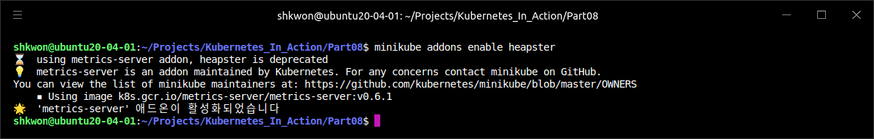
Monitoring Pod Resource Usage(3/8)
Collecting and Retrieving Actual Resource Usages :
  If you’re running a cluster in Google Kubernetes Engine, Heapster is enabled by default. If you’re using Minikube, it’s available as an add-on and can be enabled with the following command :
  To run Heapster manually in other types of Kubernetes clusters, you can refer to instructions located at https://github.com/kubernetes/heapster.
  NOTE : Now the heapster is deprecated(2023.01). Use “metrics-server” instead. From now on, we will talk about the “metric-server”.
$ minikube addons enable heapster

Slide 55
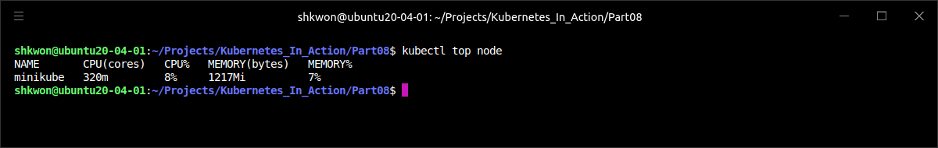
Monitoring Pod Resource Usage(4/8)
Collecting and Retrieving Actual Resource Usages :
  Running Heapster in your cluster makes it possible to obtain resource usages for nodes and individual pods through the “$ kubectl top node” command. To see how much CPU and memory is being used on your nodes, you can run the command shown in the following screenshot.
  The above screenshot shows the actual, current CPU and memory usage of all the pods running on the node, unlike the “$ kubectl describe node” command, which shows the amount of CPU and memory requests and limits instead of actual runtime usage data.
$ kubectl top node

Slide 56
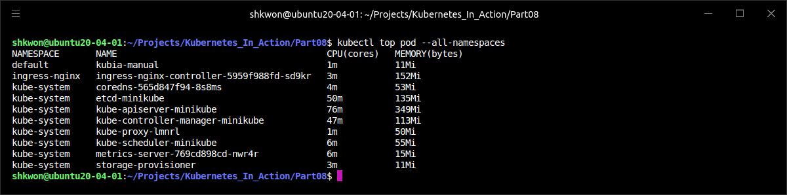
Monitoring Pod Resource Usage(5/8)
Collecting and Retrieving Actual Resource Usages :
  To see how much each individual pod is using, you can use the “$ kubectl top pod” command, as shown in the following screenshot.
$ kubectl top pod --all-namespaces

Slide 57
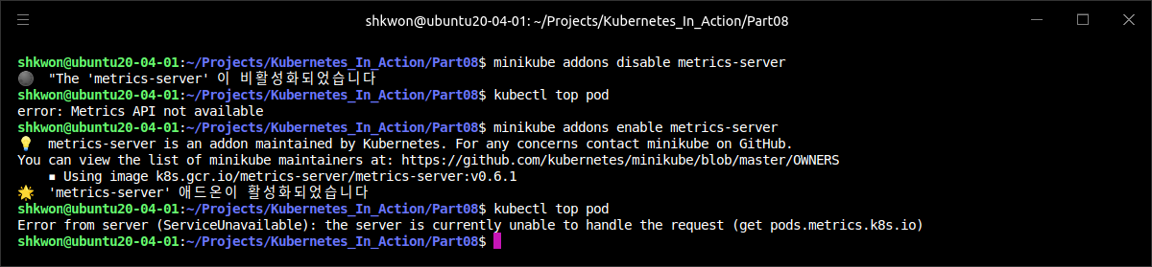
Monitoring Pod Resource Usage(6/8)
Collecting and Retrieving Actual Resource Usages :
  Sometimes the top pod command will refuse to show any metrics and instead print out an error like this :
  NOTE : If you meet the “Error from server…”, don’t start looking for the cause of the above error yet. Relax, wait a while, and rerun the command—it may take a few minutes, but the metrics should appear eventually. The “$ kubectl top” command gets the metrics from “metrics-server”, which aggregates the data over a few minutes and doesn’t expose it immediately.
  TIP : To see resource usages across individual containers instead of pods, you can use the “--containers” option.
$ kubectl top pod

Slide 58

NOTE : Getting the Merics for Each Containers
Using “--containers” Option :
  To get the metric information for each containers, you can use the following command.
  NOTE : To run the previous command, you need to create “kubia-manual” pod first.
$ kubectl top pod --containers

Slide 59

Monitoring Pod Resource Usage(7/8)
Storing and Analyzing Historical Resource Consumption Statistics :
  The “top” command only shows current resource usages—it doesn’t show you how much CPU or memory your pods consumed throughout the last hour, yesterday, or a week ago, for example. In fact, both cAdvisor and Heapster only hold resource usage data for a short window of time. If you want to analyze your pods’ resource consumption over longer time periods, you’ll need to run additional tools.
  When using Google Kubernetes Engine(GKE), you can monitor your cluster with Google Cloud Monitoring, but when you’re running your own local Kubernetes cluster (either through Minikube or other means), people usually use InfluxDB for storing statistics data and Grafana for visualizing and analyzing them.
  InfluxDB is an open source time-series database ideal for storing application metrics and other monitoring data. Grafana, also open source, is an analytics and visualization suite with a nice-looking web console that allows you to visualize the data stored in InfluxDB and discover how your application’s resource usage behaves over time.

Slide 60

Monitoring Pod Resource Usage(8/8)
Storing and Analyzing Historical Resource Consumption Statistics :
  Both InfluxDB and Grafana can run as pods. Deploying them is straightforward. All the necessary manifests are available in the Heapster Git repository at http://github.com/kubernetes/heapster/tree/master/deploy/kube-config/influxdb.
  When using Minikube, you don’t even need to deploy them manually, because they’re deployed along with “metrics-server” when you enable the “metrics-server” add-on.
  To discover how much of each resource your pod requires over time, open the Grafana web console and explore the predefined dashboards. Generally, you can find out the URL of Grafana’s web console with “$ kubectl cluster-info” command :
  NOTE : The above command is run in Minikube. And the result screenshot is also captured in Minikube.
  NOTE : To run the Grafana with Prometheus, please refer to https://github.com/bakins/minikube-prometheus-demo.
$ kubectl cluster-info

Slide 61
Automatic Scaling
Automatic Scaling of Pods and Cluster Nodes

Slide 62

Autoscaling
Scaling :
  Applications running in pods can be scaled out manually by increasing the replicas field in the ReplicationController, ReplicaSet, Deployment, or other scalable resource. Pods can also be scaled vertically by increasing their container’s resource requests and limits (though this can currently only be done at pod creation time, not while the pod is running). Although manual scaling is okay for times when you can anticipate load spikes in advance or when the load changes gradually over longer periods of time, requiring manual intervention to handle sudden, unpredictable traffic increases isn’t ideal.
  Luckily, Kubernetes can monitor your pods and scale them up automatically as soon as it detects an increase in the CPU usage or some other metric. If running on a cloud infrastructure, it can even spin up additional nodes if the existing ones can’t accept any more pods.
  The autoscaling feature in Kubernetes was completely rewritten between the 1.6 and the 1.7 version, so be aware you may find outdated information on this subject online.

Slide 63
Horizontal Pod Autoscaling(1/27)
Understanding Autoscaling Process :
  Horizontal pod autoscaling is the automatic scaling of the number of pod replicas managed by a controller. It’s performed by the Horizontal controller, which is enabled and configured by creating a HorizontalPodAutoscaler (HPA) resource. The controller periodically checks pod metrics, calculates the number of replicas required to meet the target metric value configured in the HorizontalPodAutoscaler resource, and adjusts the replicas field on the target resource (Deployment, ReplicaSet, ReplicationController, or StatefulSet).
  The autoscaling process can be split into three steps :
    Obtain metrics of all the pods managed by the scaled resource object.
    Calculate the number of pods required to bring the metrics to (or close to) the specified target value.
    Update the replicas field of the scaled resource.

Slide 64
Horizontal Pod Autoscaling(2/27)
Understanding Autoscaling Process :
  The Autoscaler doesn’t perform the gathering of the pod metrics itself. It gets the metrics from a different source. Pod and node metrics are collected by an agent called cAdvisor, which runs in the Kubelet on each node, and then aggregated by the cluster-wide component called Heapster(or metrics-server). The horizontal pod autoscaler controller gets the metrics of all the pods by querying Heapster through REST calls. The flow of metrics data is shown in the following figure (although all the connections are initiated in the opposite direction).
  This implies that Heapster must be running in the cluster for autoscaling to work. If you’re using Minikube, Heapster should already be enabled in your cluster(or you need to run “$ minikube addons enable metrics-server” command). If not, make sure to enable the Heapster add-on before trying out any autoscaling examples.
  Although you don’t need to query Heapster directly, if you’re interested in doing so, you’ll find both the Heapster Pod and the Service it’s exposed through in the kube-system namespace.
metrics-server

Slide 65

NOTE : How the Autoscaler Obtains Metrics
Change History :
  Prior to Kubernetes version 1.6, the HorizontalPodAutoscaler obtained the metrics from Heapster directly. In version 1.8, the Autoscaler can get the metrics through an aggregated version of the resource metrics API by starting the Controller Manager with the “--horizontal-pod-autoscaler-use-rest-clients=true” flag. From version 1.9, this behavior is enabled by default.
  The core API server will not expose the metrics itself. From version 1.7, Kubernetes allows registering multiple API servers and making them appear as a single API server. This allows it to expose metrics through one of those underlying API servers.
  Selecting what metrics collector to use in their clusters will be up to cluster administrators. A simple translation layer is usually required to expose the metrics in the appropriate API paths and in the appropriate format.

Slide 66

Horizontal Pod Autoscaling(3/27)
Understanding Autoscaling Process :
  Once the Autoscaler has metrics for all the pods belonging to the resource the Autoscaler is scaling (the Deployment, ReplicaSet, ReplicationController, or StatefulSet resource), it can use those metrics to figure out the required number of replicas. It needs to find the number that will bring the average value of the metric across all those replicas as close to the configured target value as possible. The input to this calculation is a set of pod metrics (possibly multiple metrics per pod) and the output is a single integer (the number of pod replicas).
  When the Autoscaler is configured to consider only a single metric, calculating the required replica count is simple. All it takes is summing up the metrics values of all the pods, dividing that by the target value set on the “HorizontalPodAutoscaler“ resource, and then rounding it up to the next-larger integer. The actual calculation is a bit more involved than this, because it also makes sure the Autoscaler doesn’t thrash around when the metric value is unstable and changes rapidly.

Slide 67
Horizontal Pod Autoscaling(4/27)
Understanding Autoscaling Process :
  When autoscaling is based on multiple pod metrics (for example, both CPU usage and Queries-Per-Second [QPS]), the calculation isn’t that much more complicated. The Autoscaler calculates the replica count for each metric individually and then takes the highest value (for example, if four pods are required to achieve the target CPU usage, and three pods are required to achieve the target QPS, the Autoscaler will scale to four pods).
  The following figure shows this example.

Slide 68
Horizontal Pod Autoscaling(5/27)
Understanding Autoscaling Process :
  The final step of an autoscaling operation is updating the desired replica count field on the scaled resource object (a ReplicaSet, for example) and then letting the ReplicaSet controller take care of spinning up additional pods or deleting excess ones.
  The Autoscaler controller modifies the replicas field of the scaled resource through the Scale sub-resource. It enables the Autoscaler to do its work without knowing any details of the resource it’s scaling, except for what’s exposed through the Scale sub-resource (see the following figure).
  This allows the Autoscaler to operate on any scalable resource, as long as the API server exposes the Scale sub-resource for it. Currently, it’s exposed for
    Deployments
    ReplicaSets
    ReplicationControllers
    StatefulSets

Slide 69
Horizontal Pod Autoscaling(6/27)
Understanding Autoscaling Process :
  In the following figure, the arrows leading from the pods to the cAdvisors, which continue on to Heapster and finally to the Horizontal Pod Autoscaler, indicate the direction of the flow of metrics data. It’s important to be aware that each component gets the metrics from the other components periodically (that is, cAdvisor gets the metrics from the pods in a continuous loop; the same is also true for Heapster and for the HPA controller).
  The end effect is that it takes quite a while for the metrics data to be propagated and a rescaling action to be performed. It isn’t immediate.
  NOTE : For more information about HorizontalPodAutoscaler, refer to https://kubernetes.io/docs/tasks/run-application/horizontal-pod-autoscale/.

Slide 70

Horizontal Pod Autoscaling(7/27)
Scaling Based on CPU Utilization :
  Perhaps the most important metric you’ll want to base autoscaling on is the amount of CPU consumed by the processes running inside your pods. Imagine having a few pods providing a service. When their CPU usage reaches 100% it’s obvious they can’t cope with the demand anymore and need to be scaled either up (vertical scaling—increasing the amount of CPU the pods can use) or out (horizontal scaling—increasing the number of pods). By doing that, the average CPU usage should come down.
  Because CPU usage is usually unstable, it makes sense to scale out even before the CPU is completely swamped—perhaps when the average CPU load across the pods reaches or exceeds 80%. But 80% of what, exactly?
  TIP : Always set the target CPU usage well below 100% (and definitely never above 90%) to leave enough room for handling sudden load spikes.
  NOTE : For periodic real-time applications, the deadline miss will be occurred if the CPU usage is over 69%(almost 70%).

Slide 71

Horizontal Pod Autoscaling(8/27)
Scaling Based on CPU Utilization :
  The process running inside a container is guaranteed the amount of CPU requested through the resource requests specified for the container. But at times when no other processes need CPU, the process may use all the available CPU on the node. When someone says a pod is consuming 80% of the CPU, it’s not clear if they mean 80% of the node’s CPU, 80% of the pod’s guaranteed CPU (the resource request), or 80% of the hard limit configured for the pod through resource limits.
  As far as the Autoscaler is concerned, only the pod’s guaranteed CPU amount (the CPU requests) is important when determining the CPU utilization of a pod. The Autoscaler compares the pod’s actual CPU consumption and its CPU requests, which means the pods you’re autoscaling need to have CPU requests set (either directly or indirectly through a LimitRange object) for the Autoscaler to determine the CPU utilization percentage.

Slide 72
Horizontal Pod Autoscaling(9/27)
Scaling Based on CPU Utilization :
  Let’s see how to create a HorizontalPodAutoscaler now and configure it to scale pods based on their CPU utilization. You’ll create a Deployment, and you’ll need to make sure the pods created by the Deployment all have the CPU resource requests specified in order to make autoscaling possible. You’ll have to add a “CPU resource request” to the Deployment’s pod template, as shown in the following listing.
  This is a regular Deployment object—it doesn’t use autoscaling yet. It will run three instances of the “kubia” NodeJS app, with each instance requesting “100 millicores” of CPU.
apiVersion: apps/v1
kind: Deployment
metadata:
name: kubia
spec:
replicas: 3
template:
metadata:
name: kubia
labels:
app: kubia
spec:
containers:
- image: knix008/kubia:v1
name: nodejs
resources:
requests:
cpu: 100m
selector:
matchLabels:
app: kubia
deployment.yaml

Slide 73

Horizontal Pod Autoscaling(10/27)
Scaling Based on CPU Utilization :
  After creating the Deployment, to enable horizontal autoscaling of its pods, you need to create a HorizontalPodAutoscaler (HPA) object and point it to the Deployment. You could prepare and post the YAML manifest for the HPA, but an easier way exists—using the “$ kubectl autoscale” command :
  This creates the HPA object for you and sets the Deployment called “kubia” as the scaling target. You’re setting the target CPU utilization of the pods to 30% and specifying the minimum and maximum number of replicas. The Autoscaler will constantly keep adjusting the number of replicas to keep their CPU utilization around 30%, but it will never scale down to less than one or scale up to more than five replicas.
  TIP : Always make sure to autoscale Deployments instead of the underlying ReplicaSets. This way, you ensure the desired replica count is preserved across application updates (remember that a Deployment creates a new ReplicaSet for each version). The same rule applies to manual scaling, as well.
$ kubectl autoscale deployment kubia --cpu-percent=30 --min=1 --max=5

Slide 74


Horizontal Pod Autoscaling(11/27)
Scaling Based on CPU Utilization :
  Let’s look at the definition of the HorizontalPodAutoscaler resource to gain a better understanding of it. It’s shown in the following screenshot.
$ kubectl get hpa.v2.autoscaling kubia -o yaml

Slide 75

NOTE : The Whole Output
Autoscaler :
  You can see the following screenshot for more information from the output of the previous command.

Slide 76

Horizontal Pod Autoscaling(12/27)
Scaling Based on CPU Utilization :
  It takes a while for cAdvisor to get the CPU metrics and for Heapster(metrics-server in Minikube) to collect them before the Autoscaler can take action. During that time, if you display the HPA resource with “$ kubectl get hpa” command :
  Because you’re running three pods that are currently receiving no requests, which means their CPU usage should be close to zero, you should expect the Autoscaler to scale them down to a single pod, because even with a single pod, the CPU utilization will still be below the 30% target. And sure enough, the autoscaler does exactly that. It soon scales the Deployment down to a single replica.
$ kubectl get hpa

Slide 77

Horizontal Pod Autoscaling(13/27)
Scaling Based on CPU Utilization :
  Remember, the autoscaler only adjusts the desired replica count on the Deployment. The Deployment controller then takes care of updating the desired replica count on the ReplicaSet object, which then causes the ReplicaSet controller to delete two excess pods, leaving one pod running.
  You can use “$ kubectl describe hpa” command to see more information on the HorizontalPodAutoscaler and the operation of the underlying controller, as the following screenshot shows.
$ kubectl describe hpa

Slide 78

Horizontal Pod Autoscaling(14/27)
Scaling Based on CPU Utilization :
  Now, you’ll start sending requests to your pod, thereby increasing its CPU usage, and you should see the autoscaler detect this and start up additional pods.
  You’ll need to expose the pods through a Service, so you can hit all of them through a single URL. You may remember that the easiest way to do that is with “$ kubectl expose” command :
$ kubectl expose deployment kubia --port=80 --target-port=8080

Slide 79

Horizontal Pod Autoscaling(15/27)
Scaling Based on CPU Utilization :
  Before you start hitting your pod(s) with requests, you may want to run the following command in a separate terminal to keep an eye on what’s happening with the HorizontalPodAutoscaler and the Deployment, as shown in the following screenshot.
  NOTE : List multiple resource types with “$ kubectl get” command by delimiting them with a comma.
  If you’re using OSX, you’ll have to replace the “watch” command with a loop, manually run “$ kubectl get” periodically, or use kubectl’s “--watch” option. But although a plain “$ kubectl get” can show multiple types of resources at once, that’s not the case when using the aforementioned “--watch” option, so you’ll need to use two terminals if you want to watch both the HPA and the Deployment objects.
$ watch -n 1 kubectl get hpa,deployment

Slide 80

Horizontal Pod Autoscaling(16/27)
Scaling Based on CPU Utilization :
  Keep an eye on the state of those two objects while you run a load-generating pod. You’ll run the following command in another terminal :
  This will run a pod which repeatedly hits the “kubia” Service. You’ve seen the “-it” option a few times when running the “$ kubectl exec” command. As you can see, it can also be used with “$ kubectl run”. It allows you to attach the console to the process, which will not only show you the process’ output directly, but will also terminate the process as soon as you press “CTRL+C”. The “--rm” option causes the pod to be deleted afterward, and the “--restart=Never” option causes “$ kubectl run” to create an unmanaged pod directly instead of through a Deployment object, which you don’t need.
  This combination of options is useful for running commands inside the cluster without having to piggyback on an existing pod. It not only behaves the same as if you were running the command locally, it even cleans up everything when the command terminates.
$ kubectl run -it --rm --restart=Never loadgenerator --image=busybox -- sh -c "while true; do wget -O - -q http://kubia.default; done"

Slide 81

Horizontal Pod Autoscaling(17/27)
Scaling Based on CPU Utilization :
  As the load-generator pod runs, you’ll see it initially hitting the single pod. As before, it takes time for the metrics to be updated, but when they are, you’ll see the autoscaler increase the number of replicas.
  NOTE : If the CPU load in your case doesn’t exceed 30%, try running additional load-generators.
  Again, you can inspect autoscaler events with “$ kubectl describe” command to see what the autoscaler has done (only the most important information is shown in the following screenshot).
$ kubectl describe hpa

Slide 82
Horizontal Pod Autoscaling(18/27)
Scaling Based on CPU Utilization :
  NOTE : A container’s CPU utilization is the container’s actual CPU usage divided by its requested CPU. The requested CPU defines the minimum, not maximum amount of CPU available to the container, so a container may consume more than the requested CPU, bringing the percentage over 100.
  Before we go on, let’s do a little math and see how the autoscaler concluded that four replicas are needed. Initially, there was one replica handling requests and its CPU usage spiked to 108%. Dividing 108 by 30 (the target CPU utilization percentage) gives 3.6, which the autoscaler then rounded up to 4. If you divide 108 by 4, you get 27%. If the autoscaler scales up to four pods, their average CPU utilization is expected to be somewhere in the neighborhood of 27%, which is close to the target value of 30% and almost exactly what the observed CPU utilization was.

Slide 83

Horizontal Pod Autoscaling(19/27)
Scaling Based on CPU Utilization :
  The initial CPU usage could spike even higher. Even if the initial average CPU utilization was higher (say 150%), requiring five replicas to achieve the 30% target, the autoscaler would still only scale up to four pods in the first step, because it has a limit on how many replicas can be added in a single scale-up operation. The autoscaler will at most double the number of replicas in a single operation, if more than two current replicas exist. If only one or two exist, it will scale up to a maximum of four replicas in a single step.
  Additionally, it has a limit on how soon a subsequent autoscale operation can occur after the previous one. Currently, a scale-up will occur only if no rescaling event occurred in the last three minutes. A scale-down event is performed even less frequently—every five minutes. Keep this in mind so you don’t wonder why the autoscaler refuses to perform a rescale operation even if the metrics clearly show that it should.

Slide 84


Horizontal Pod Autoscaling(20/27)
Scaling Based on CPU Utilization :
  Maybe your initial CPU utilization target of 30% was a bit too low, so increase it to 60%. You do this by editing the HPA resource with the “$ kubectl edit” command. When the text editor opens, change the “target.AverageUtilization” field to 60, as shown in the following listing.
$ kubectl edit hpa

Slide 85


Horizontal Pod Autoscaling(21/27)
Scaling Based on CPU Utilization :
  As with most other resources, after you modify the resource, your changes will be detected by the autoscaler controller and acted upon. You could also delete the resource and recreate it with different target values, because by deleting the HPA resource, you only disable autoscaling of the target resource (a Deployment in this case) and leave it at the scale it is at that time. The automatic scaling will resume after you create a new HPA resource for the Deployment.

Slide 86

Horizontal Pod Autoscaling(22/27)
Scaling Based on Memory Consumption :
  You’ve seen how easily the horizontal Autoscaler can be configured to keep CPU utilization at the target level. But what about autoscaling based on the pods’ memory usage?
  Memory-based autoscaling is much more problematic than CPU-based autoscaling. The main reason is because after scaling up, the old pods would somehow need to be forced to release memory. This needs to be done by the app itself—it can’t be done by the system. All the system could do is kill and restart the app, hoping it would use less memory than before. But if the app then uses the same amount as before, the Autoscaler would scale it up again. And again, and again, until it reaches the maximum number of pods configured on the HPA resource. Obviously, this isn’t what anyone wants. Memory-based autoscaling was introduced in Kubernetes version 1.8, and is configured exactly like CPU-based autoscaling.

Slide 87

Horizontal Pod Autoscaling(23/27)
Scaling Based on Other and Custom Metrics :
  To have the autoscaler use custom, app-defined metrics to drive its autoscaling decisions was fairly complicated. The initial design of the autoscaler didn’t make it easy to move beyond simple CPU-based scaling. This prompted the Kubernetes Autoscaling Special Interest Group (SIG) to redesign the autoscaler completely.
  Instead of going through a complete example here, let’s quickly go over how to configure the autoscaler to use different metrics sources. We’ll start by examining how we defined what metric to use in our previous example. The following listing shows how your previous HPA object was configured to use the CPU usage metric.
  As you can see, the metrics field allows you to define more than one metric to use. In the above screenshot, you’re using a single metric. Each entry defines the type of metric—in this case, a Resource metric. You have three types of metrics you can use in an HPA object :
    Resource
    Pods
    Object

Slide 88
Horizontal Pod Autoscaling(24/27)
Scaling Based on Other and Custom Metrics :
  The Resource type makes the autoscaler base its autoscaling decisions on a resource metric, like the ones specified in a container’s resource requests.
  The Pods type is used to refer to any other (including custom) metric related to the pod directly. An example of such a metric could be the already mentioned “Queries-Per-Second (QPS)” or the number of messages in a message broker’s queue (when the message broker is running as a pod). To configure the autoscaler to use the pod’s QPS metric, the HPA object would need to include the entry shown in the following listing under its “metrics” field.
  The example in the above listing configures the autoscaler to keep the average QPS of all the pods managed by the ReplicaSet (or other) controller targeted by this HPA resource at 100.
  NOTE : For more information, refer to https://kubernetes.io/docs/tasks/run-application/horizontal-pod-autoscale-walkthrough/.
  NOTICE : I didn’t test the above and the next example.
...
spec:
…
metrics:
- resource:
name: qps
target:
averageValue: 100
type: Pods
...

Slide 89
Horizontal Pod Autoscaling(25/27)
Scaling Based on Other and Custom Metrics :
  The Object metric type is used when you want to make the autoscaler scale pods based on a metric that doesn’t pertain directly to those pods. For example, you may want to scale pods according to a metric of another cluster object, such as an Ingress object. The metric could be QPS as in listed in the previous page, the average request latency, or something else completely.
  Unlike in the previous case, where the autoscaler needed to obtain the metric for all targeted pods and then use the average of those values, when you use an Object metric type, the autoscaler obtains a single metric from the single object. In the HPA definition, you need to specify the target object and the target value. The following listing shows an example.
  In the above example, the HPA is configured to use the latencyMillis metric of the frontend Ingress object. The target value for the metric is 20. The horizontal pod autoscaler will monitor the Ingress’ metric and if it rises too far above the target value, the autoscaler will scale the “kubia” Deployment resource.
...
spec:
metrics:
- type: Object
resource:
name: latencyMillis
target:
apiVersion: apps/v1
kind: Ingress
name: frontend
targetValue: 20
scaleTargetRef:
apiVersion: apps/v1
kind: Deployment
name: kubia
...

Slide 90

Horizontal Pod Autoscaling(26/27)
Determining Which Metrics are Appropriate for Autoscaling :
  You need to understand that not all metrics are appropriate for use as the basis of autoscaling. As mentioned previously, the pods’ containers’ memory consumption isn’t a good metric for autoscaling. The autoscaler won’t function properly if increasing the number of replicas doesn’t result in a linear decrease of the average value of the observed metric (or at least close to linear).
  For example, if you have only a single pod instance and the value of the metric is “X” and the autoscaler scales up to two replicas, the metric needs to fall to somewhere close to “X/2”. An example of such a custom metric is “Queries per Second (QPS)”, which in the case of web applications reports the number of requests the application is receiving per second. Increasing the number of replicas will always result in a proportionate decrease of QPS, because a greater number of pods will be handling the same total number of requests.
  NOTE : Before you decide to base the autoscaler on your app’s own custom metric, be sure to think about how its value will behave when the number of pods increases or decreases.

Slide 91

Horizontal Pod Autoscaling(27/27)
Scaling Down to Zero Replicas :
  The horizontal pod autoscaler currently doesn’t allow setting the “minReplicas” field to 0, so the autoscaler will never scale down to zero, even if the pods aren’t doing anything. Allowing the number of pods to be scaled down to zero can dramatically increase the utilization of your hardware. When you run services that get requests only once every few hours or even days, it doesn’t make sense to have them running all the time, eating up resources that could be used by other pods. But you still want to have those services available immediately when a client request comes in.
  This is known as “idling” and “un-idling”. It allows pods that provide a certain service to be scaled down to zero. When a new request comes in, the request is blocked until the pod is brought up and then the request is finally forwarded to the pod.

Slide 92

Vertical Pod Autoscaling(1/3)
Scale Up :
  Horizontal scaling is great, but not every application can be scaled horizontally. For such applications, the only option is to scale them vertically—give them more CPU and/or memory. Because a node usually has more resources than a single pod requests, it should almost always be possible to scale a pod vertically, right?
  Because a pod’s resource requests are configured through fields in the pod manifest, vertically scaling a pod would be performed by changing those fields. But, it’s currently not possible to change either resource requests or limits of existing pods.

Slide 93

Vertical Pod Autoscaling(2/3)
Automatically Configuring Resource Requests :
  An experimental feature sets the CPU and memory requests on newly created pods, if their containers don’t have them set explicitly. The feature is provided by an “Admission Control” plugin called “InitialResources”. When a new pod without resource requests is created, the plugin looks at historical resource usage data of the pod’s containers (per the underlying container image and tag) and sets the requests accordingly.
  You can deploy pods without specifying resource requests and rely on Kubernetes to eventually figure out what each container’s resource needs are. Effectively, Kubernetes is vertically scaling the pod. For example, if a container keeps running out of memory, the next time a pod with that container image is created, its resource request for memory will be set higher automatically.

Slide 94

Vertical Pod Autoscaling(3/3)
Modifying Resource Requests While a Pod is Running :
  Eventually, the same mechanism will be used to modify an existing pod’s resource requests, which means it will vertically scale the pod while it’s running. Please refer to the Kubernetes documentation to find out whether vertical pod autoscaling is implemented or not.
  For Amazon or Google, you can refer to https://docs.aws.amazon.com/ko_kr/eks/latest/userguide/vertical-pod-autoscaler.html or https://cloud.google.com/kubernetes-engine/docs/concepts/verticalpodautoscaler.

Slide 95

Horizontal Scaling of Cluster Nodes(1/9)
Cluster Autoscaler :
  The Horizontal Pod Autoscaler creates additional pod instances when the need for them arises. But what about when all your nodes are at capacity and can’t run any more pods? Obviously, this problem isn’t limited only to when new pod instances are created by the Autoscaler. Even when creating pods manually, you may encounter the problem where none of the nodes can accept the new pods, because the node’s resources are used up by existing pods.
  In that case, you’d need to delete several of those existing pods, scale them down vertically, or add additional nodes to your cluster. If your Kubernetes cluster is running on premises, you’d need to physically add a new machine and make it part of the Kubernetes cluster. But if your cluster is running on a cloud infrastructure, adding additional nodes is usually a matter of a few clicks or an API call to the cloud infrastructure. This can be done automatically, right?
  Kubernetes includes the feature to automatically request additional nodes from the cloud provider as soon as it detects additional nodes are needed. This is performed by the “Cluster Autoscaler”.

Slide 96

Horizontal Scaling of Cluster Nodes(2/9)
Cluster Autoscaler :
  The Cluster Autoscaler takes care of automatically provisioning additional nodes when it notices a pod that can’t be scheduled to existing nodes because of a lack of resources on those nodes. It also de-provisions nodes when they’re underutilized for longer periods of time. A new node will be provisioned if, after a new pod is created, the Scheduler can’t schedule it to any of the existing nodes. The Cluster Autoscaler looks out for such pods and asks the cloud provider to start up an additional node. But before doing that, it checks whether the new node can even accommodate the pod. After all, if that’s not the case, it makes no sense to start up such a node.
  Cloud providers usually group nodes into groups (or pools) of same-sized nodes (or nodes having the same features). The Cluster Autoscaler thus can’t simply say “Give me an additional node.” It needs to also specify the node type.
  The Cluster Autoscaler does this by examining the available node groups to see if at least one node type would be able to fit the unscheduled pod. If exactly one such node group exists, the Autoscaler can increase the size of the node group to have the cloud provider add another node to the group. If more than one option is available, the Autoscaler must pick the best one. The exact meaning of “best” will obviously need to be configurable. In the worst case, it selects a random one.
Cluster Autoscaler

Slide 97
Horizontal Scaling of Cluster Nodes(3/9)
Cluster Autoscaler :
  A simple overview of how the cluster Autoscaler reacts to an unschedulable pod is shown in the following figure. When the new node starts up, the Kubelet on that node contacts the API server and registers the node by creating a Node resource. From then on, the node is part of the Kubernetes cluster and pods can be scheduled to it.

Slide 98
Horizontal Scaling of Cluster Nodes(4/9)
Cluster Autoscaler :
  The Cluster Autoscaler also needs to scale down the number of nodes when they aren’t being utilized enough. The Autoscaler does this by monitoring the requested CPU and memory on all the nodes. If the CPU and memory requests of all the pods running on a given node are below 50%, the node is considered unnecessary.
  That’s not the only determining factor in deciding whether to bring a node down. The Autoscaler also checks to see if any system pods are running (only) on that node (apart from those that are run on every node, because they’re deployed by a DaemonSet, for example). If a system pod is running on a node, the node won’t be relinquished. The same is also true if an unmanaged pod or a pod with local storage is running on the node, because that would cause disruption to the service the pod is providing. In other words, a node will only be returned to the cloud provider if the Cluster Autoscaler knows the pods running on the node will be rescheduled to other nodes.
  When a node is selected to be shutdown, the node is first marked as unschedulable and then all the pods running on the node are evicted. Because all those pods belong to ReplicaSets or other controllers, their replacements are created and scheduled to the remaining nodes (that’s why the node that’s being shutdown is first marked as unschedulable).

Slide 99

NOTE : Manually Cordoning and Draining Nodes
Marking a Node as Unschedulable :
  A node can also be marked as unschedulable and drained manually. Without going into specifics, this is done with the following “kubectl” commands :
    “$ kubectl cordon <node>” marks the node as unschedulable (but doesn’t do anything with pods running on that node).
    “$ kubectl drain <node>” marks the node as unschedulable and then evicts all the pods from the node.
  In both cases, no new pods are scheduled to the node until you uncordon it again with “$ kubectl uncordon <node>”.

Slide 100
Horizontal Scaling of Cluster Nodes(5/9)
Enabling the Cluster Autoscaler :
  Cluster autoscaling is available on
    Google Kubernetes Engine (GKE)
    Google Compute Engine (GCE)
    Amazon Web Services (AWS)
    Microsoft Azure
  How you start the Autoscaler depends on where your Kubernetes cluster is running. For your “kubia” cluster running on GKE, you can enable the Cluster Autoscaler like the following command :
  If your cluster is running on GCE, you need to set three environment variables before running “kube-up.sh” :
    KUBE_ENABLE_CLUSTER_AUTOSCALER=true
    KUBE_AUTOSCALER_MIN_NODES=3
    KUBE_AUTOSCALER_MAX_NODES=5
  For more information, refer to the Cluster Autoscaler GitHub repo at https://github.com/kubernetes/autoscaler/tree/master/cluster-autoscaler/
  NOTE : The Cluster Autoscaler publishes its status to the “cluster-autoscaler-status” ConfigMap in the kube-system namespace.
$ gcloud container clusters update kubia --enable-autoscaling --min-nodes=3 --max-nodes=5

Slide 101

Horizontal Scaling of Cluster Nodes(6/9)
Limiting Service Disruption during Cluster Scale-down :
  When a node fails unexpectedly, nothing you can do will prevent its pods from becoming unavailable. But when a node is shutdown voluntarily, either by the Cluster Autoscaler or by a human operator, you can make sure the operation doesn’t disrupt the service provided by the pods running on that node through an additional feature.
  Certain services require that a minimum number of pods always keeps running; this is especially true for quorum-based clustered applications. For this reason, Kubernetes provides a way of specifying the minimum number of pods that need to keep running while performing these types of operations. This is done by creating a “PodDisruptionBudget” resource.

Slide 102

Horizontal Scaling of Cluster Nodes(7/9)
Limiting Service Disruption during Cluster Scale-down :
  The PodDisruptionBudget contains only a pod label selector and a number specifying the minimum number of pods that must always be available or, starting from Kubernetes version 1.7, the maximum number of pods that can be unavailable. We’ll look at what a “PodDisruptionBudget (PDB)” resource manifest looks like, but instead of creating it from a YAML file, you’ll create it with “$ kubectl create poddisruptionbudget” command and then obtain and examine the YAML later.
  If you want to ensure three instances of your “kubia” pod are always running (they have the label “app=kubia”), create the PodDisruptionBudget resource like this :
$ kubectl create -f deployment.yaml
$ kubectl create pdb kubia-pdb --selector=app=kubia --min-available=3

Slide 103

Horizontal Scaling of Cluster Nodes(8/9)
Limiting Service Disruption during Cluster Scale-down :
  Now, retrieve the PDB’s YAML. It’s shown in the next screenshot :
$ kubectl get pdb kubia-pdb -o yaml

Slide 104

Horizontal Scaling of Cluster Nodes(9/9)
Limiting Service Disruption during Cluster Scale-down :
  You can also use a percentage instead of an absolute number in the “minAvailable” field. For example, you could state that 60% of all pods with the “app=kubia” label need to be running at all times.
  NOTE : Starting with Kubernetes 1.7, the PodDisruptionBudget resource also supports the “maxUnavailable” field, which you can use instead of “minAvailable” if you want to block evictions when more than that many pods are unavailable.
  As long as the PodDisruptionBudget exists, both the Cluster Autoscaler and the “$ kubectl drain” command will adhere to it and will never evict a pod with the “app=kubia” label if that would bring the number of such pods below three.
  For example, if there were four pods altogether and “minAvailable” was set to three as in the example, the pod eviction process would evict pods one by one, waiting for the evicted pod to be replaced with a new one by the “ReplicaSet” controller, before evicting another pod.

Slide 105

NOTE : Big Picture - The Kubernetes Cluster

Slide 106

NOTE : Kubernetes Cheat Sheet

Slide 107

Reference
[1] Kubernetes in Action, Marko Luksa, Manning, 2018 1st Edition.
[2] https://github.com/luksa/kubernetes-in-action
[3] https://minikube.sigs.k8s.io/docs/
[4] https://kubernetes.io/docs/reference/kubectl/cheatsheet/

Slide 108

? & !

